Slide 1
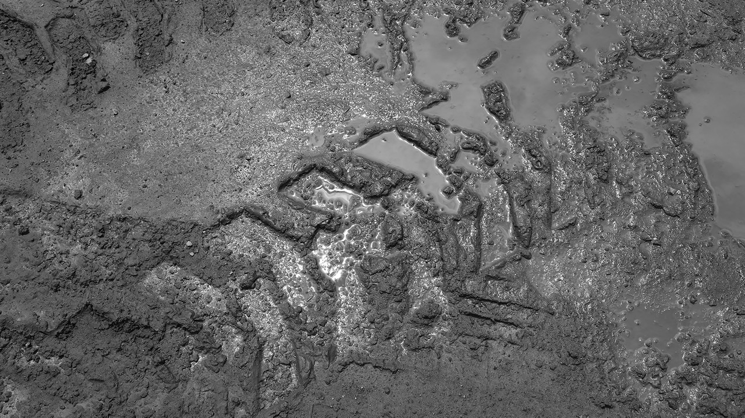
Geofences
TennaU February 2023

Slide 2
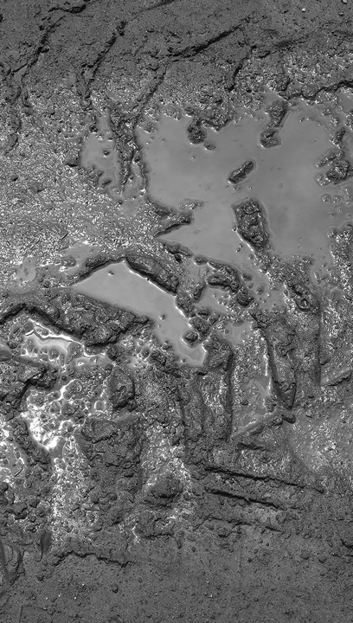
Jose Cueva
Co-Founder
Meet the Team
Tom Caliendo
Lead UI/UX Designer
Tom Caliendo
Lead UI/UX Designer
Moderator: Colleen Lyerla | Marketing Communications

Slide 3
Overview
Designate select areas of your projects, yards, and offices to monitor where your equipment assets are for better construction equipment management.
Boundaries, Fences, & Zones
Draw precise borders around locations and to manage utilization, prevent theft, and be better informed about resources and schedules.
Reports
Quickly access information and details about sites, geofences, and assets entering and leaving designated locations.
Agenda
Live Geofence
Receive timely alerts when assets leave or enter a geofenced area, regardless of when a trip is completed.
Alerts
Set as many alerts as desired for each boundary, zone, or fence to alert users to enters and exits for specific asset categories.

Slide 4
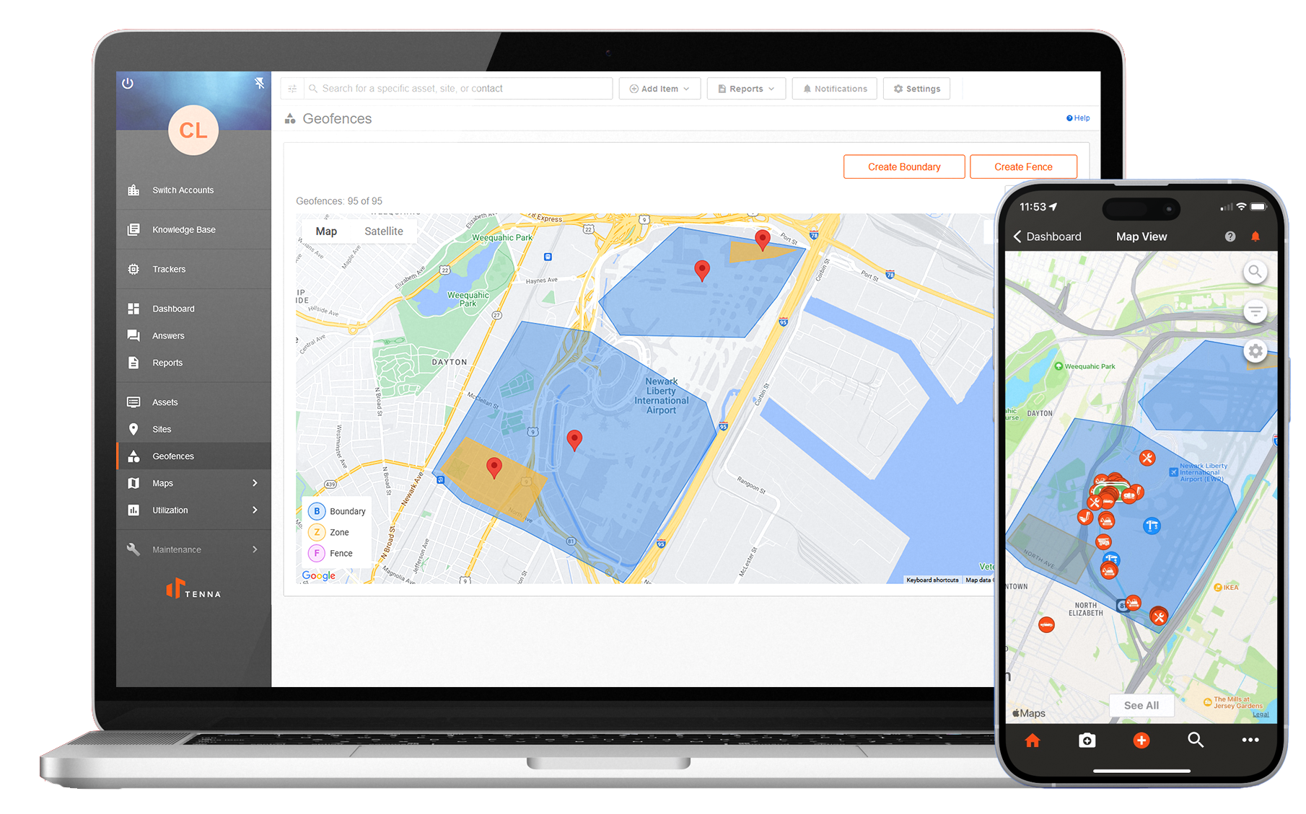
What Are Geofences?
Geofences identify a specific location on a map.
As assets pass in and out of Geofences, their movements are recorded to keep track for historical record keeping as well as job costs and billing.
Notes:
This is probably a good slide to mention mobile functionality for geofences as there is a mobile shot here.
Talking Points
Talk about different shapes
Site needs at least one boundary
Boundaries can have multiple zones
Both boundaries and zones can be billable
Every asset can be customized to be billable
Whenever billable assets are in a project

Slide 5
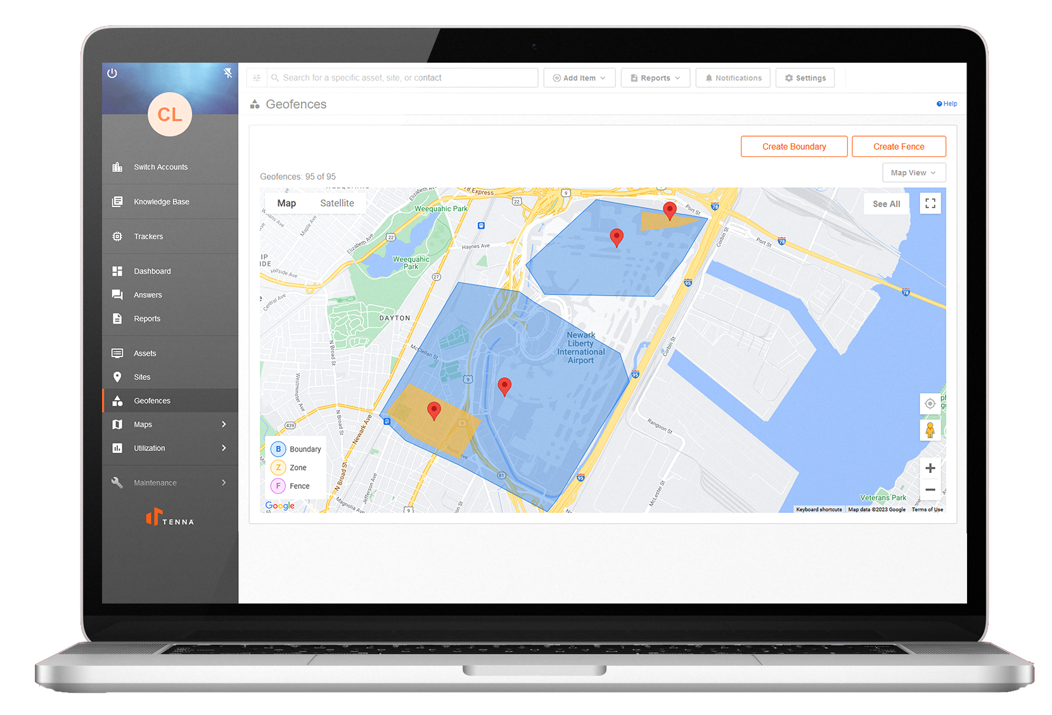
Boundaries, Fences, and Zones
There are three types of Geofences.
Boundary Goes around your Site, distinguishing its physical boundary borders. All Sites must include at least one boundary, created during Site setup. Boundaries may not overlap with any other Boundary or Fence.
Zone Goes inside a Boundary. This is for a specific area of a Site, such as a project lay down area. Zones can only exist inside a Boundary and may not overlap.
Fence Goes outside of a Boundary and is unrelated to Sites. Fences can go around a local place near the job site, such as a coffee shop or convenience store. Fences may not overlap with any other Fence or Boundary.

Slide 6
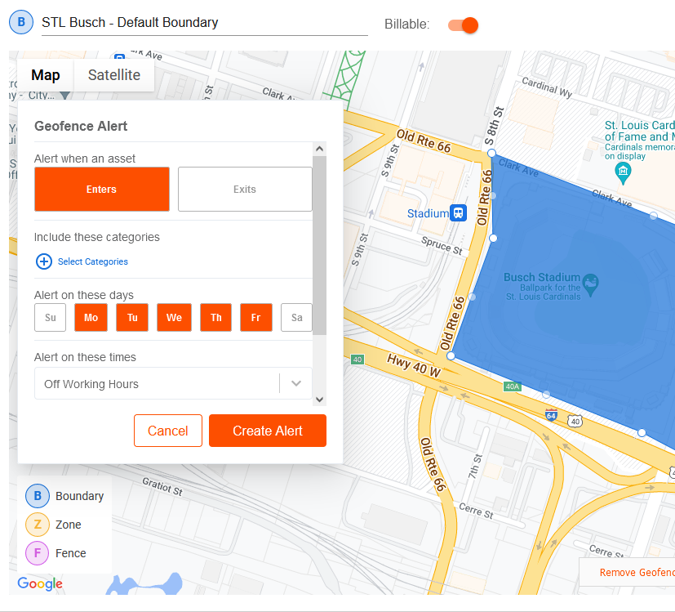
Create a Boundary
Choose whether a Geofence represents a billable site/assets. When billable assets are within a billable Geofence, their billing rates are applied to that Geofence's site to collect accurate job cost data.
Boundaries mark the virtual perimeters of a Site. All Sites should have at least one Boundary.
When setting up a Boundary, you can also create alerts for when assets enter and/or exist the location—including choosing the days and times when alerts will be triggered.

Slide 7
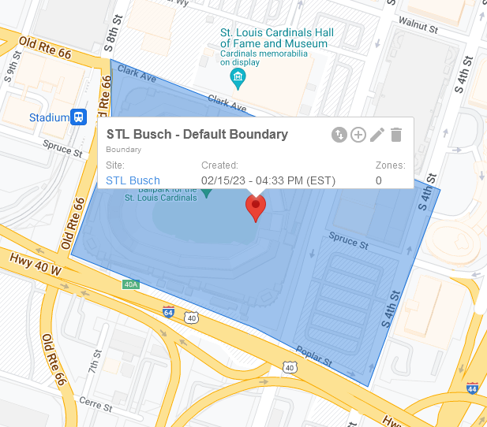
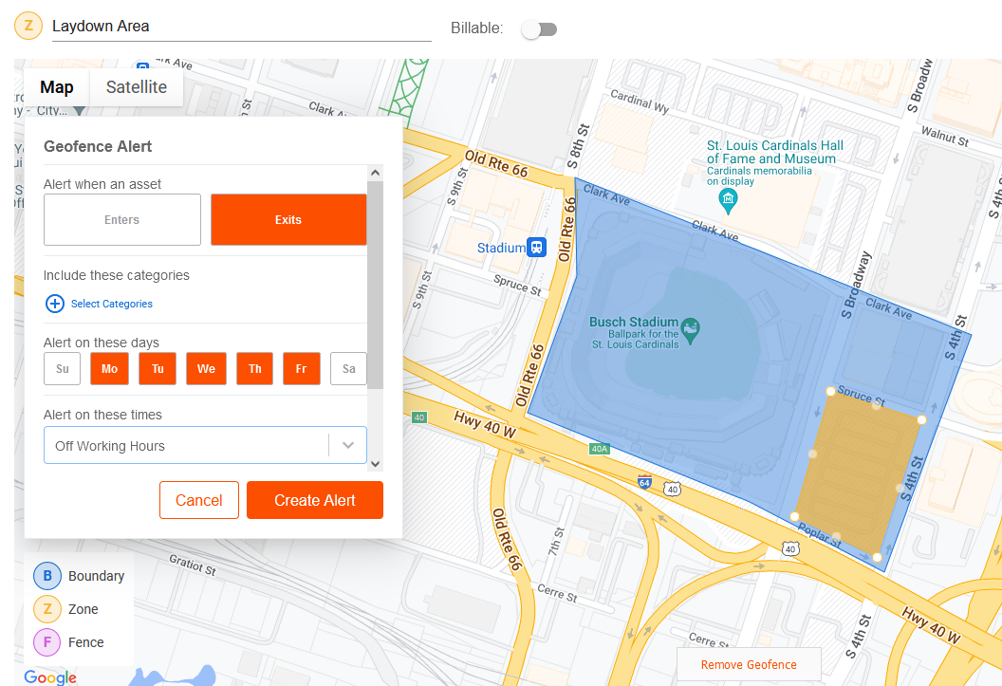
Create a Zone
Zones exist inside Boundaries.
Each Boundary has a map marker giving Site information for that Geofence. Click the + icon to create a Zone within a Boundary. Zones are useful for identifying laydown areas, project offices, and more. Alerts can also be set for Zones. Zones can also be marked as billable or non-billable. Example use case: If you have assets that are waiting to move to another Site/project, draw a non-billable Zone around them so they will not be calculated for the current site.

Slide 8
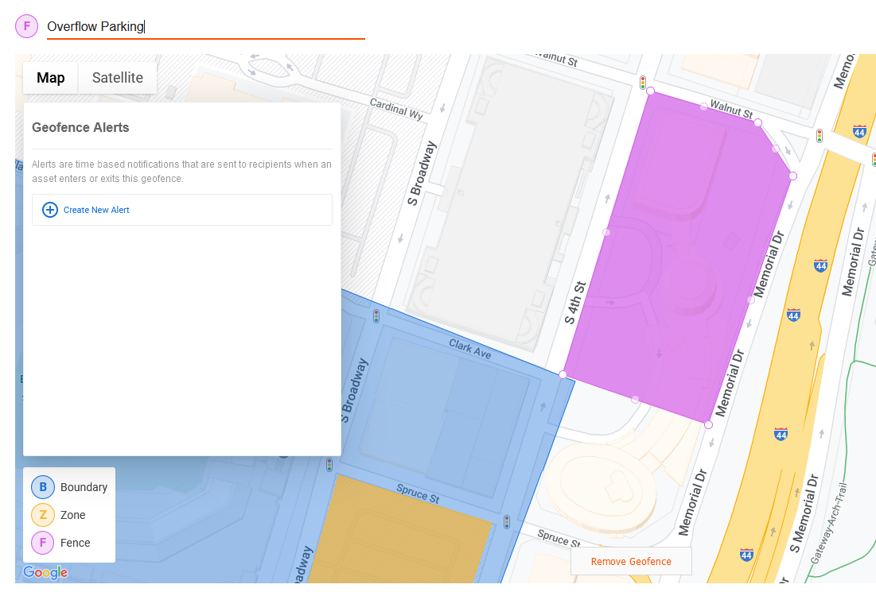
Create a Fence
Fences are virtual perimeters not tied to a site.
Fences can be drawn around any area of interest you would like to track.
Alerts can be set up for Fences, similar to Boundaries. Fences are not billable by default.

Slide 9
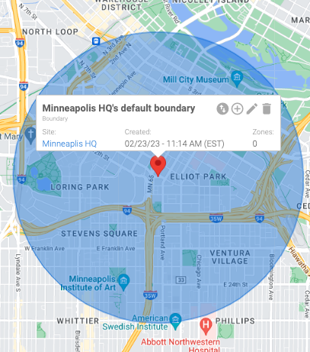
Default Boundaries Bulk Uploads
Auto Geofence creation for active sites
A default circular Boundary (1 mile radius) is created around the Site address.
If the Site address is not valid, then accurate geo coordinates can be entered during bulk upload.
Boundaries are only created for 'Active’ Sites. There cannot be any pre-existing active Boundary in that radius.
Notes:
PRO TIP - you can specify the radius during bulk upload process

Slide 10
Default Boundaries Integrations
Auto Geofence creation for inbound integrations
Tenna offers a wide variety of integration options to your existing ERP or accounting software systems. Integrations allow Tenna to read your company’s Site data from other software platforms.
Since Geofencing is exclusively a Tenna feature, Tenna will try to create a default circular Boundary around the address (~0.1 miles).
If an existing Boundary is found, Tenna will try to create a smaller rectangular Boundary to avoid any overlap with pre-existing Boundaries.

Slide 11
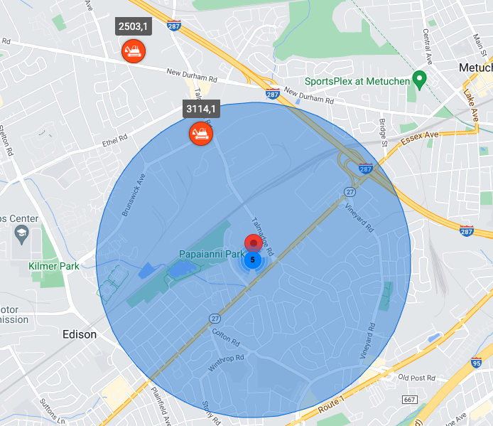
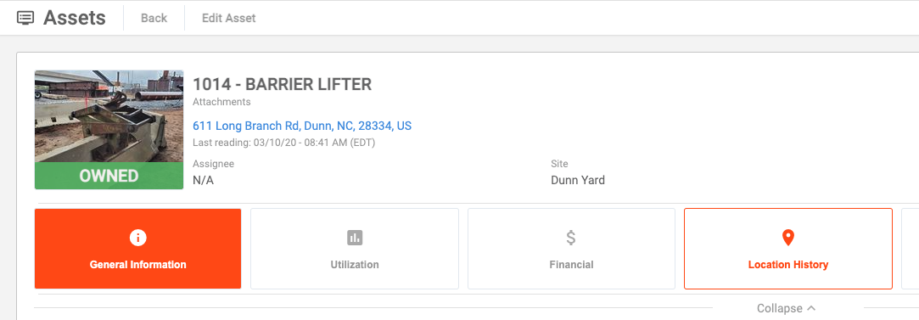
Create Geofence Auto Detection
NEW FUNCTIONALITY!
When a Geofence is drawn around existing assets on the map, Tenna automatically recalculates the following:
Any assets inside the Geofence automatically record an entry for reporting purposes.
If the Geofence is a Boundary or a Zone, any assets inside the Geofence are automatically assigned to the new project/site.
Notes:
Graphics
Master Map - which shows a combined view of assets outside geofences and inside geofences
Highlighting the report for entry and exit
Showing site assignment which is automatically updated

Slide 12
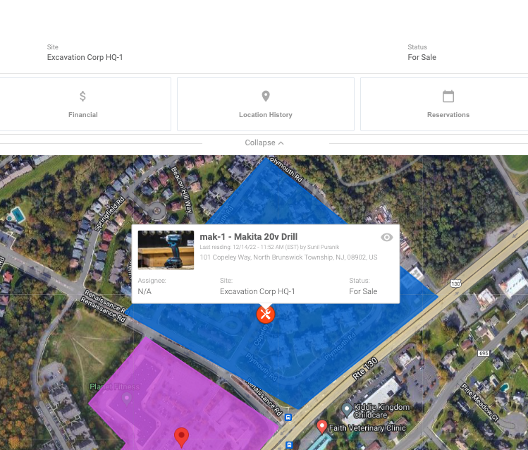
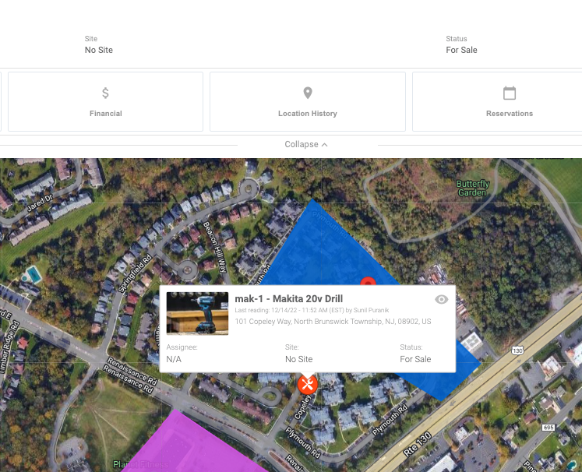
Edit Geofence Auto Detection
NEW FUNCTIONALITY!
When a Geofence is modified, Tenna now automatically recalculates the following:
Geofence entries/exits are automatically recorded for any assets that fall in or out of the Geofence after the modification.
Site assignment for any of these assets are adjusted accordingly after the modification.

Slide 13
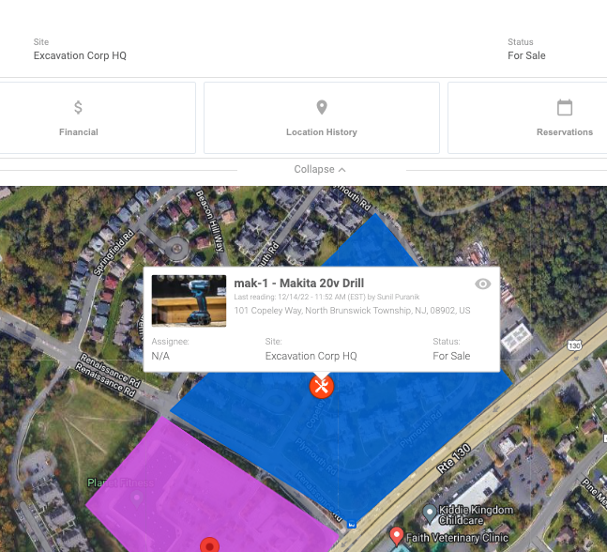
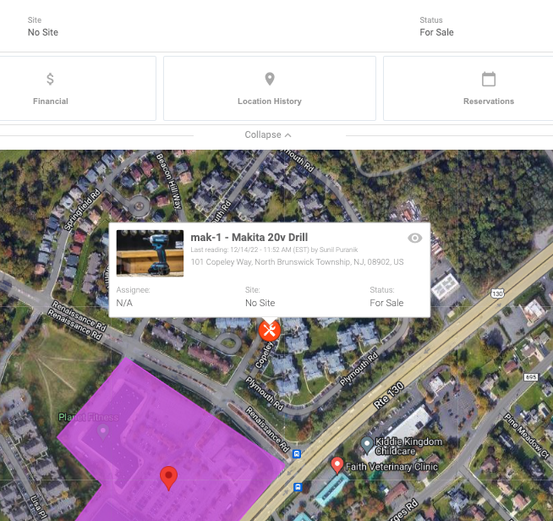
Close Site/Delete Geofence Auto Detection
NEW FUNCTIONALITY!
If a Geofence is deleted or a parent Site of a Boundary or Zone is closed, Tenna automatically recalculates the following:
Close any open Geofence entry or exit records for the Geofence.
Unassign any assets that were previously in the Geofence from their current Site assignment to 'No Site’.

Slide 14
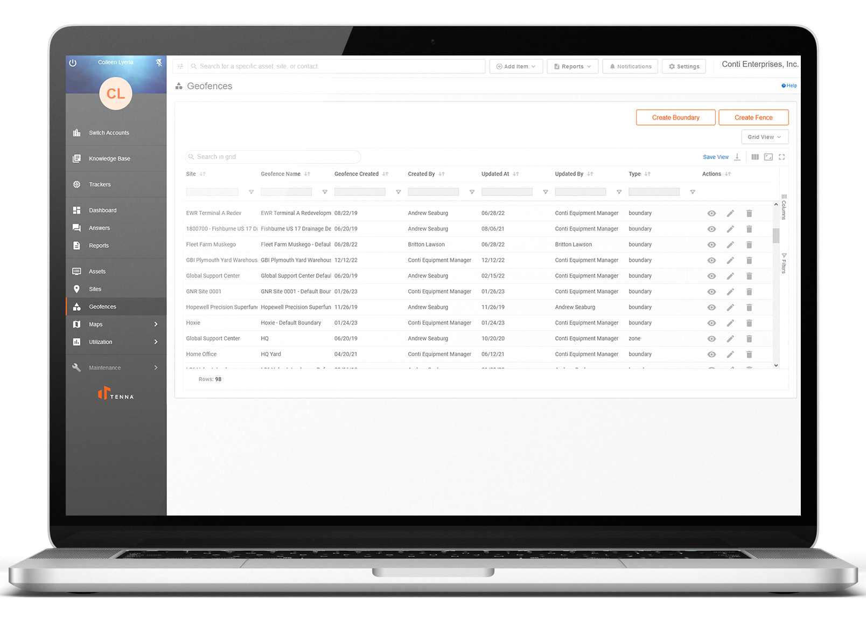
Geofence Reports
Reports include three ways to find more info on Geofence data.
The Geofence Enter & Exit Report allows you to view all asset activity coming and going from your Geofences.
The Geofence Report takes you to the grid view of all Boundaries, Zones, and Fences where you can filter and search to find more details and make desired edits. The Site Information Report makes it easy to find details about your existing Sites.
Notes:
TC – update to kill report for last two

Slide 15
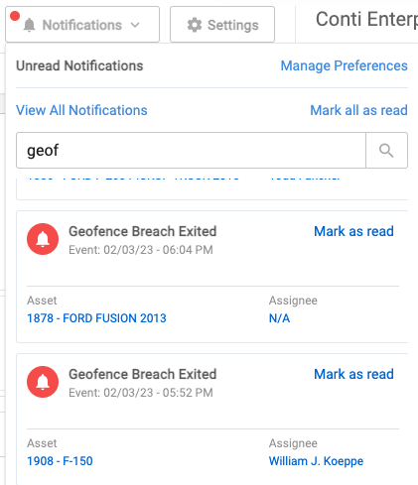
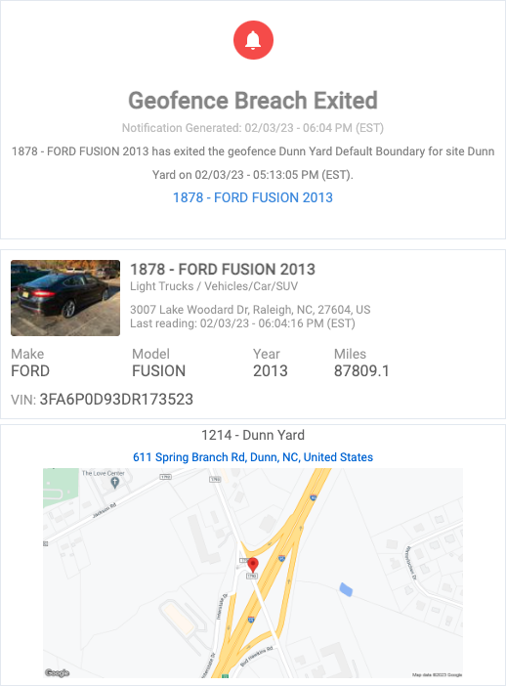
Live Geofence
NEW FUNCTIONALITY!
You can now receive all your Geofence alerts in 'Near Realtime’.
Any configured Geofence breach alerts are immediately dispatched to your phone/email or the Tenna online web application.
Notes:
SP - Show the different versions of notifications received
[1:21 PM] Jose Cueva
example
[1:21 PM] Jose Cueva
no, verbally
[1:21 PM] Jose Cueva
like "if a truck leaves the geofence and you have an alert for the weekends, then you would get a notfication within 1min"
[1:21 PM] Jose Cueva
something like that
[1:21 PM] Jose Cueva
im here
[1:21 PM] Jose Cueva
carry on
[1:22 PM] Jose Cueva
see my chat

Slide 16
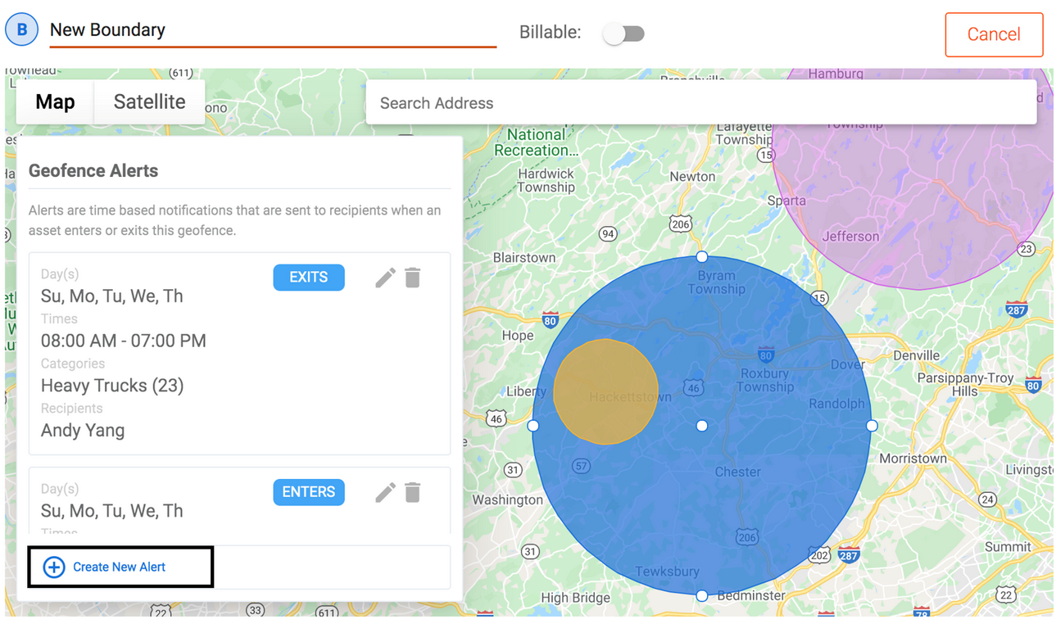
Geofence Alerts
Alerts for Boundaries, Zones, and Fences allow designated users to understand activities at that location.
Unlike other notifications, Geofence alerts are established when editing each individual Geofence. Geofence alerts are very flexible, allowing you to create multiple alerts for each Site around entry, exit, and specific asset categories, so you are notified of Geofence breach activity at the desired times.

Slide 17
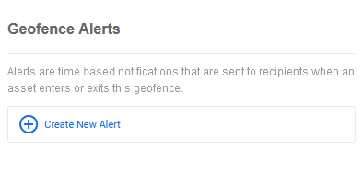
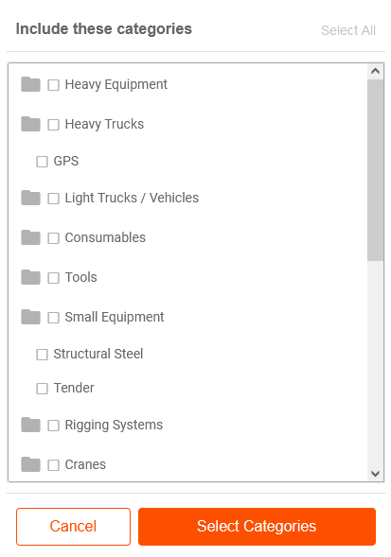
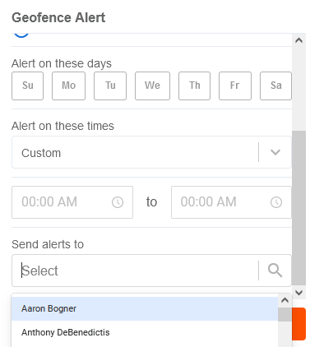
Create an Alert
Multiple alerts can be created for the same Geofence.
Alert options include:
Enters, exits, or both
Days of the week for alert triggers
Customizable times
Category of assets
Users to receive alerts

Slide 18
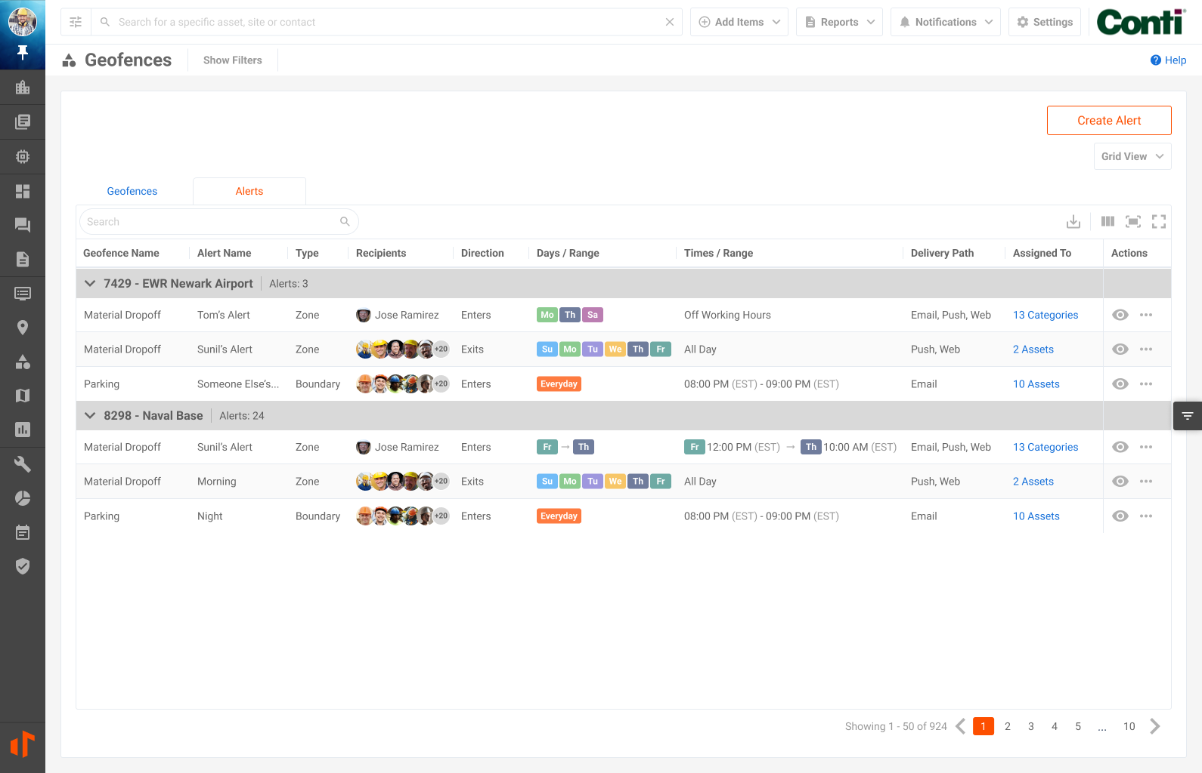
Geofence Alerts Updated Functionality
Core Geofence Enhancements
Dynamically assign categories to your alerts. This will automatically add and remove assets as they are assigned/unassigned to the linked categories.
Alerts will also be able to be assigned to one or multiple Geofences on creation.
Day Range Trigger
When creating an alert, you will now be able to create a “Day Range” trigger, which will allow you to pick a start day and time as well as an end day and time.

Slide 19
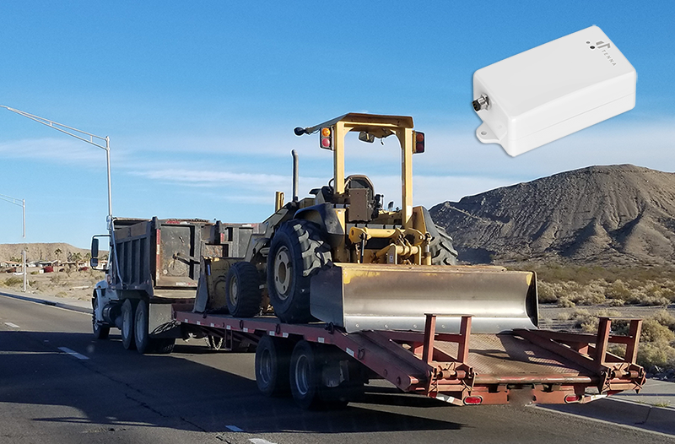
Ping On Motion for TennaMINI
Not specific to Geofences but while we have your attention…
We are rolling out hardware updates to TennaMINI Plug-In and Solar trackers that will allow for immediate alerts when motion is detected, even when the equipment is powered-off. This allows users to know if equipment is moving inside or outside of Geofences after hours, or unexpectedly, and makes it easier to find the current location of assets being towed.

Slide 20
TennaSHOP
The TennaSHOP LinkedIn Group is a place for Tenna users to connect with one another to:
Ask questions
Talk about new and unique use cases
Share best practices
Share information about integrations
Swap success stories
https://www.linkedin.com/groups/9034188/
Keep in touch!
Come see us!
AEMP Connect
March 12-13
Las Vegas, NV
AGC Annual Convention
March 13-16
Las Vegas, NV
ConExpo
March 14-18
Las Vegas, NV

Slide 21
Next on
TennaU
Custom Inspections / Safety & Compliance
March 24, 2023 1 p.m. EST

Slide 22
Thank You

