Slide 1


Resource Management + Schedule
TennaU January 2023

Slide 2



Jose Cueva
Co-Founder
Meet the
Team
Moderator: Colleen Lyerla | Marketing Communications
Tom Caliendo
Lead UI/UX Designer
Tom Caliendo
Lead UI/UX Designer

Slide 3
Requests
  Request, approve, and manage assets and labor. Create and approve requests, resolve conflicts, and review request status.
Dispatch Board
  Request, schedule, and view assets and labor by site. Create deliveries and labor or asset tasks.
Dispatch Queue
  View and manage all scheduled resources waiting to be dispatched.
Agenda
Dispatch Events
  Review details of all dispatched assets and labor.
Labor & Crew Management
  Create and manage laborer profiles and assign them to crews.
Schedule
  Quickly review all requests, upcoming maintenance, dispatch events, and current locations for each asset or labor resource.

Slide 4

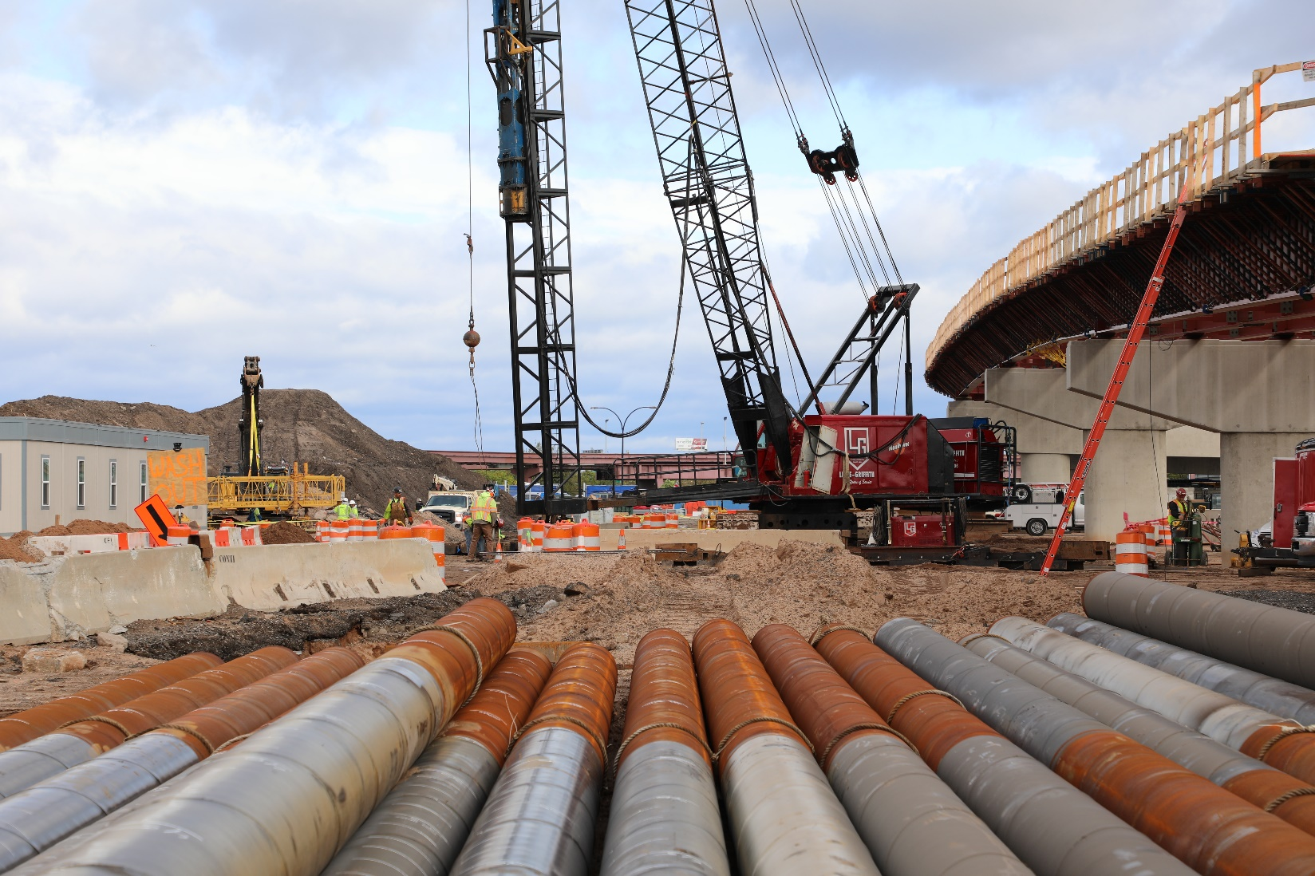
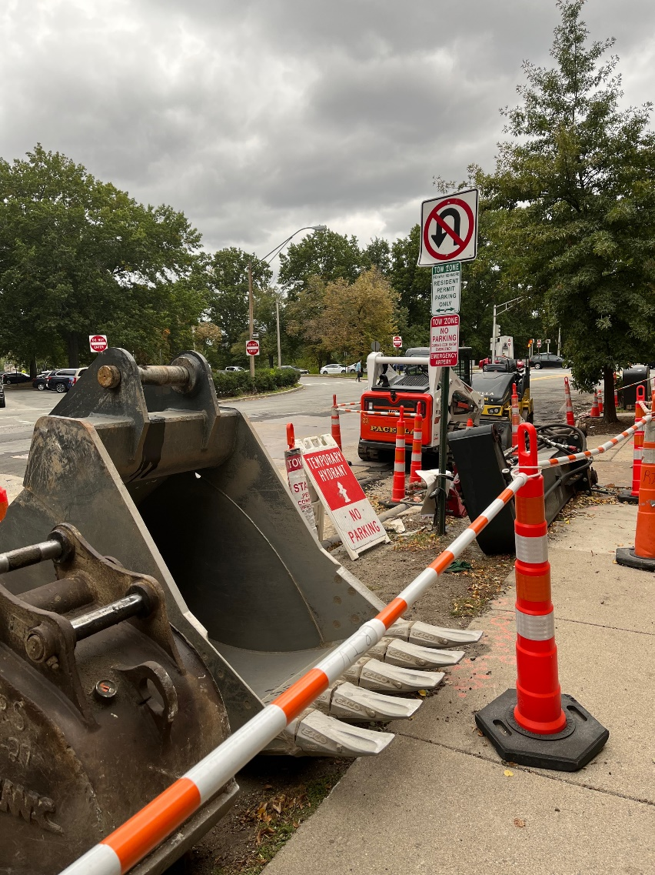


What is Resource Management?
Construction resource management is the process of planning construction resource usage to meet project objectives.
Proper project resource planning helps keep projects on schedule by ensuring that demands are met, while maximizing the utilization of resources from project to project.​
​
Construction resource management is used to:​
Track resource availability ​
Reallocate resources in response to project changes​
Track utilization rates to avoid under utilization or overworking your teams​
Ensure project teams have the right skills and experience​
Optimize resource time, effort, and cost​
Identify and resolve resource conflicts​
Forecasting future staffing requirements​

Slide 5
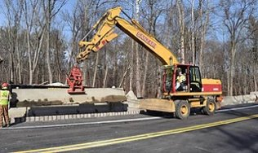
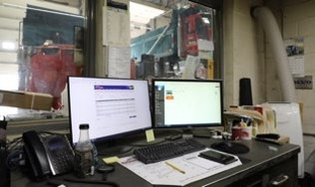

Workflow from boots to suits
Field / Job Site
  Access assets on their job in real time.​
  Request assets and crews/labor easily.
  Plan your resources based on your job schedule.
  Notify the shop if an asset breaks in less than a minute.​
  Removing tension from the field by hours and miles updating accurately and automatically.
Shop / Yard
  Receive requests for equipment digitally.
  PM is fully autonomous.​
  Maintenance from the field.​
  Significant time given back by cutting down calls from the field.​
  Work orders for mechanics.​
Office / C-Suite
  Easily accessible reporting.​
  Utilization by asset or project.​
  View of asset and crew/labor schedules.
  Automatic cost reporting to jobs.​
  Buying/selling/renting decisions.​

Slide 6


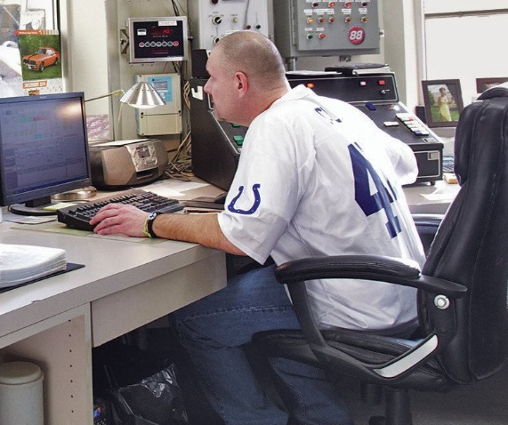
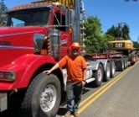
Key personas
Requestor
  In the field / on the job site, keeping things on schedule and putting out fires.
  Finger on the pulse of what’s needed in the field. ​
  Seeing immediate needs and first line of defense for missing or malfunctioning assets. ​
  Needs expedient decisions on reallocating, moving, or renting necessary equipment. ​​
Approver
  President/COO/VP Ops/Equipment Manager/Dispatcher​
  Has decision making authority on equipment and resource moves.​
  Has overview of all resource allocations. ​
  Office based but also mobile. ​
  Constantly communicating via phone, text, or email about resource needs. ​
Dispatcher
  Office based--- has large monitor and web app open all day. ​
  Bombarded with phone calls, emails, texts, about resource needs. ​
  Reactive to changes in the field. ​
  May or may not have decision making authority on equipment moves. ​
  Communicates dispatch deliveries and tasks daily. ​
Driver
  On the go--- heavily reliant on their phone. ​
  Makes decisions about moves and tasks based on state restrictions for heavy loads. ​
  Plans day around major moves. ​
  Needs to communicate back and forth about changes on schedule or needs. ​

Slide 7
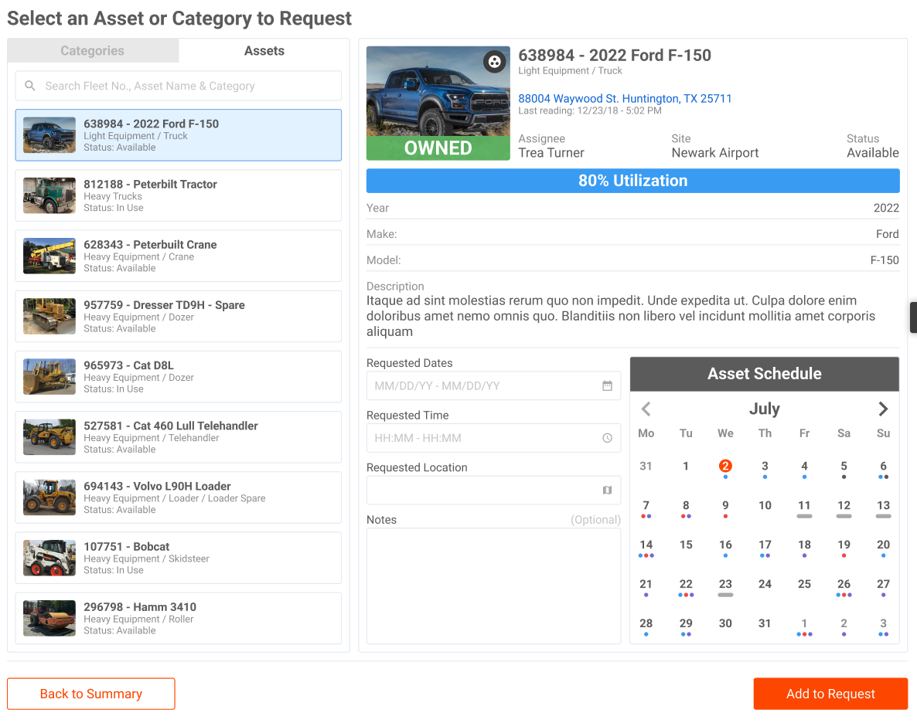
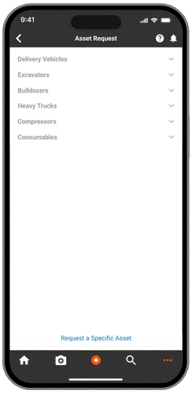
Requests
  Request, approve, and manage assets and labor. Create and approve requests, resolve conflicts, and review request status.
  Easily select assets, attachments, vehicles, and laborers from your desktop or the field.
  Get notified when requested assets have grouped attachments that should be included.
  Review all requests from one consolidated view.
  Quickly spot requests with conflicts and resolve or deny them.
  Find your own requests and check status.

Slide 8
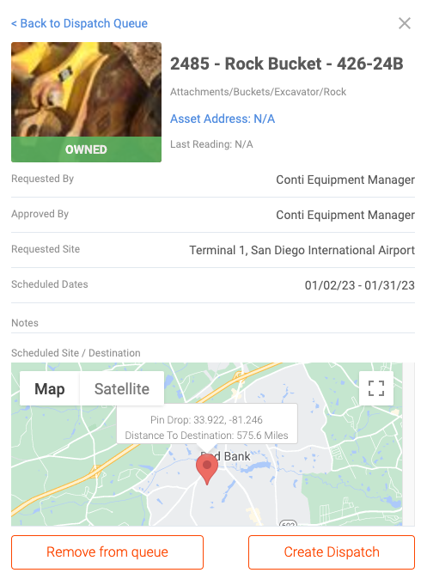
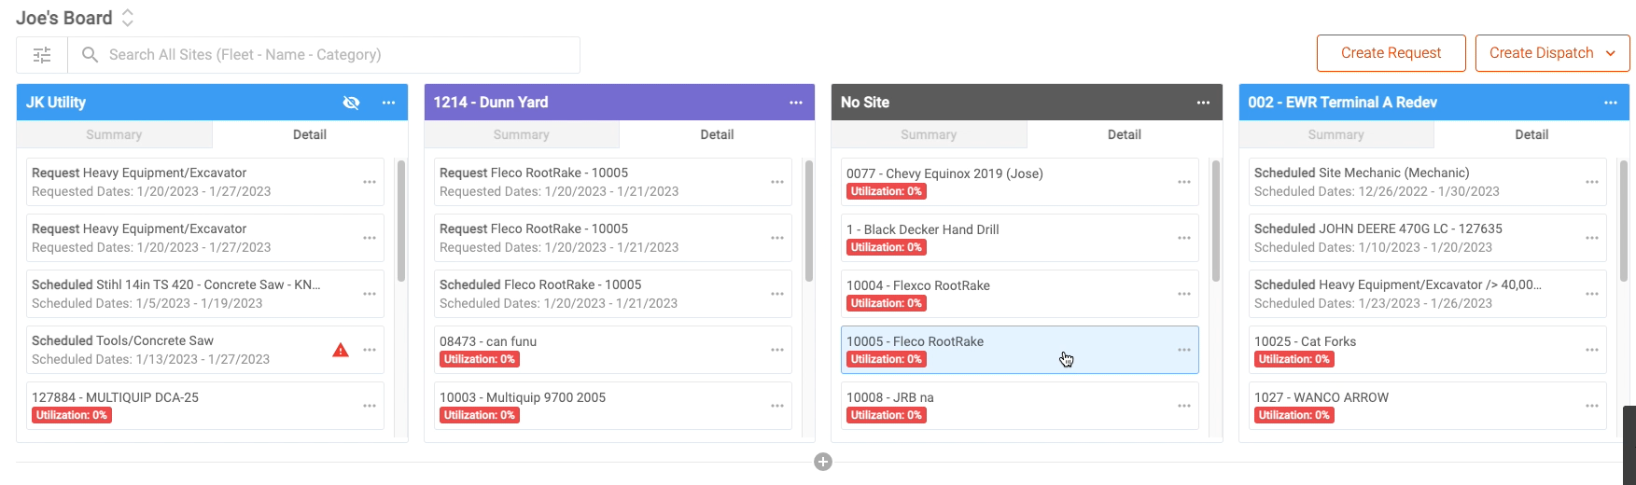
Dispatch Board
  Request, schedule, and view assets and labor by site. Create deliveries and labor or asset tasks.
  Dashboard view makes it easy to see every asset assigned to every job site.
  View asset details
  Take action on pending requests for specific sites
  Create requests, dispatch tasks, and more

Slide 9
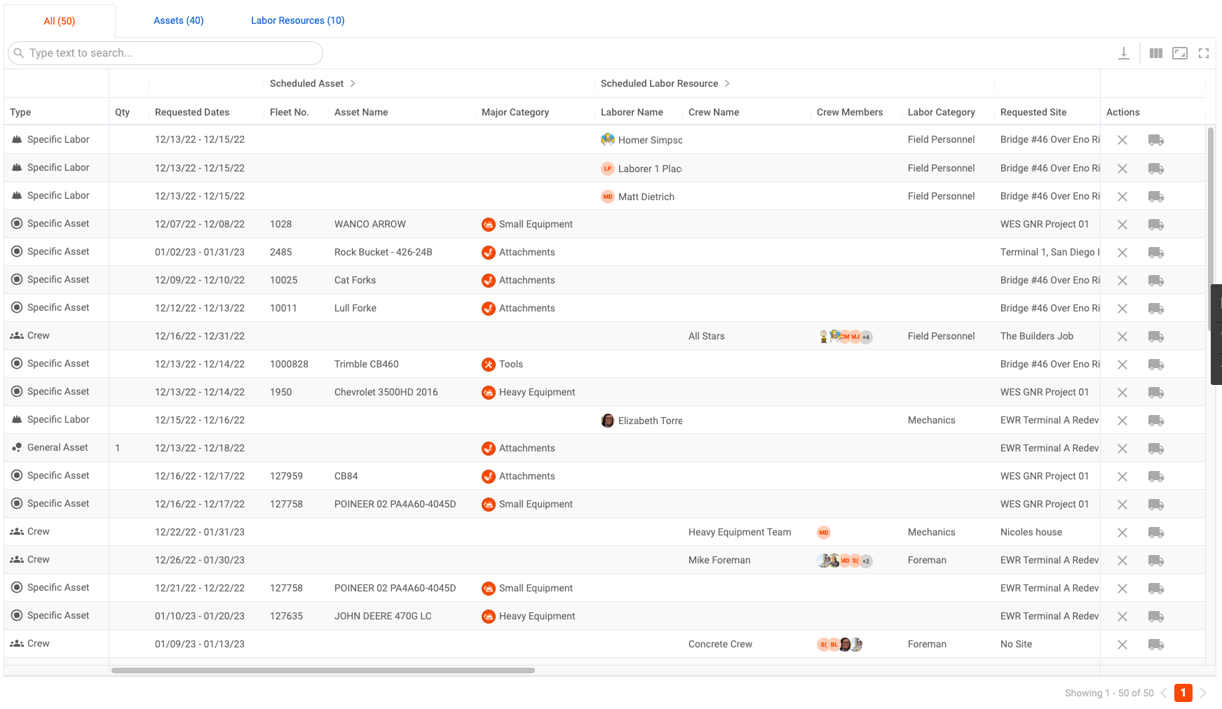
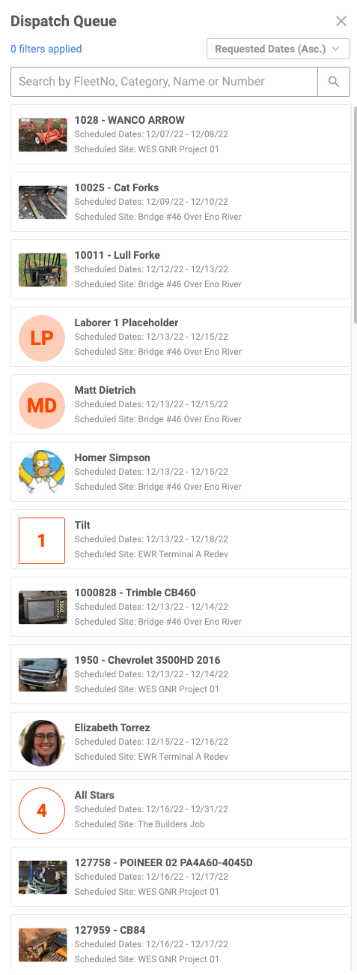
Dispatch Queue
  View and manage all scheduled resources waiting to be dispatched.
  Create delivery, asset, and labor tasks
  For general requests, select the specific asset or laborer who meets the task/site requirements
  Quickly evaluate status of all dispatch events to keep projects on schedule
  Quickly open requests and dispatch panels to see all pending tasks

Slide 10
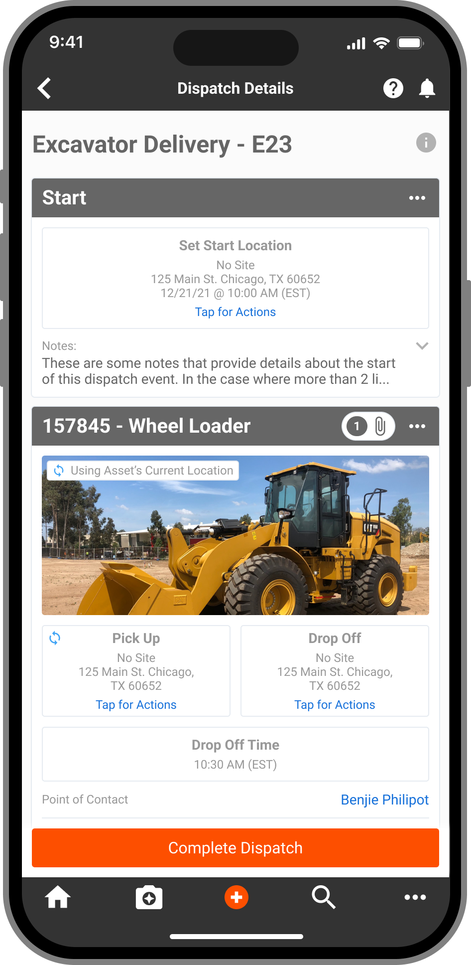
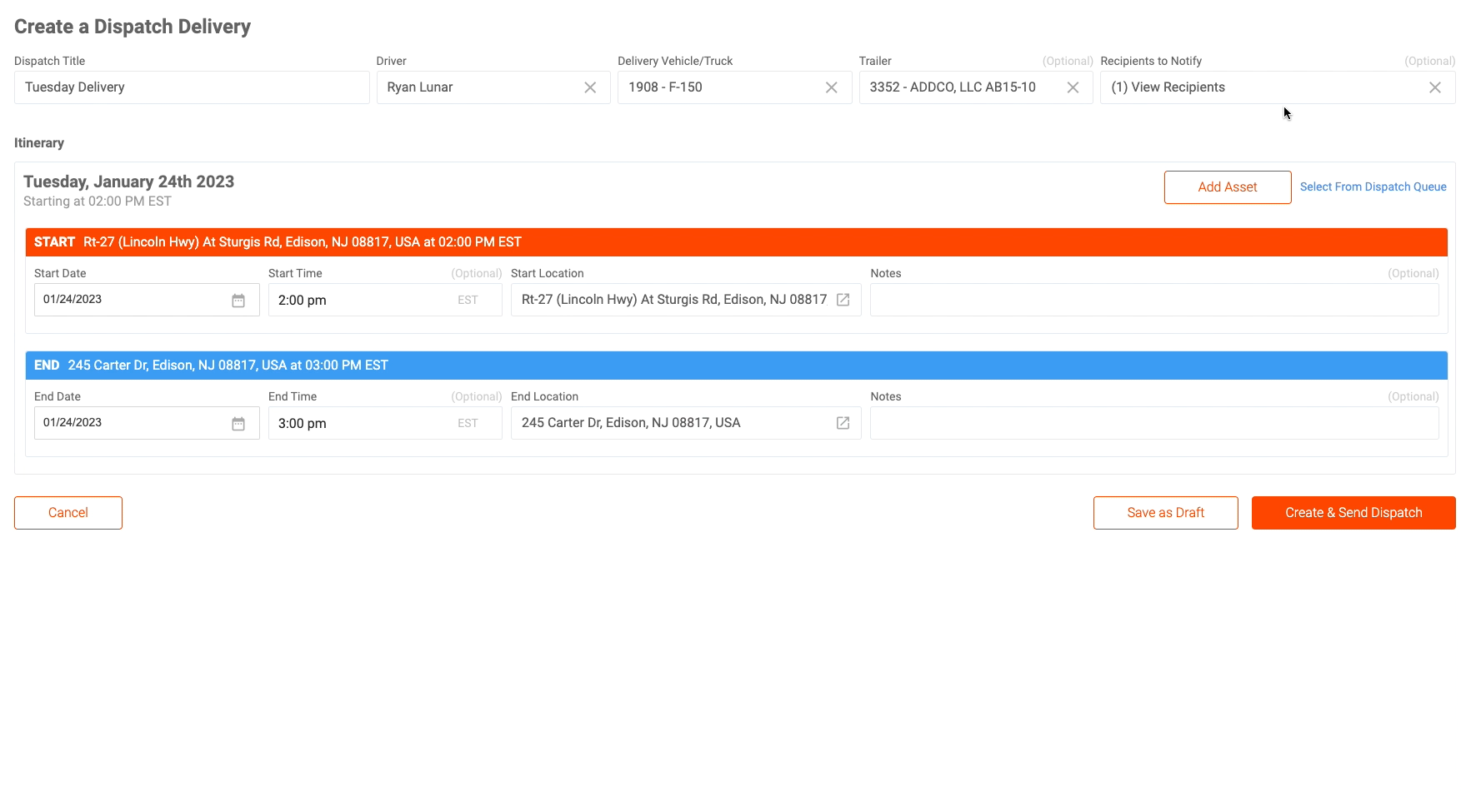
Dispatch Events
  Review details of all dispatched assets and labor.
  See what’s completed, in progress, or canceled
  Resend notifications to approvers as needed
  Create dispatch events

Slide 11
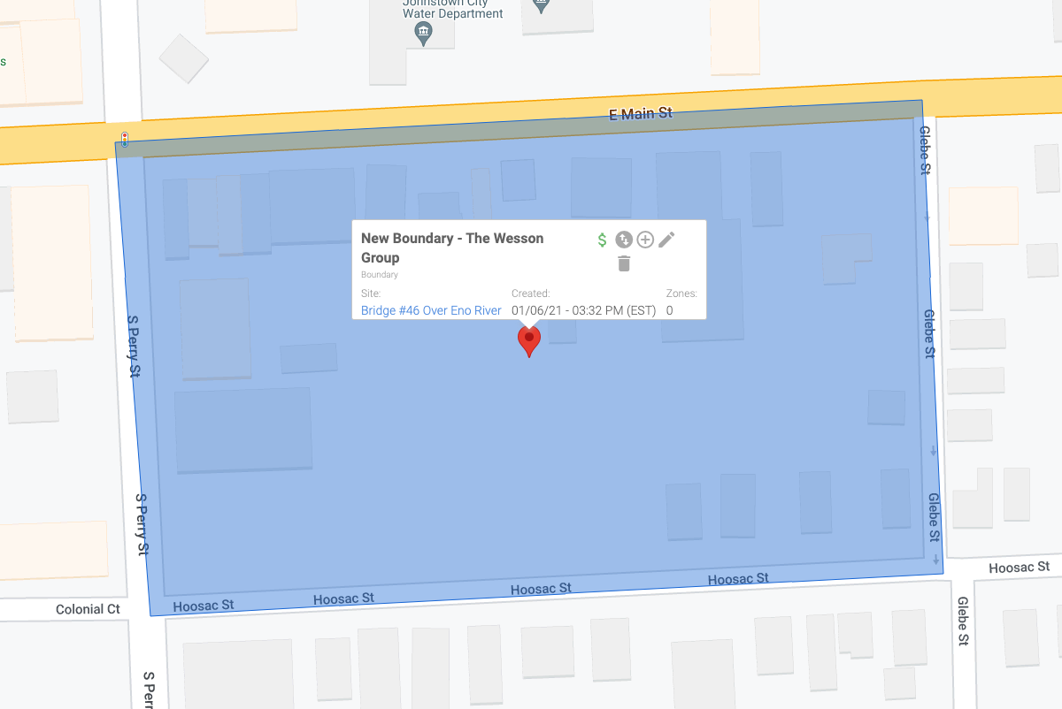
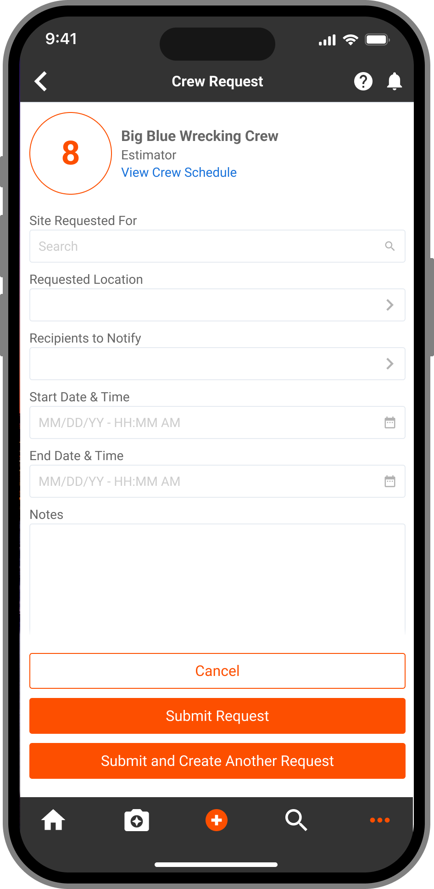

Labor Management
  Create and manage laborer profiles and assign them to crews.
  Add laborers to the platform individually or by bulk upload
  Assign resource type, trade, trade level, and classification to make it easier for requestors to choose appropriate personnel for a project or job site
  Group laborers into crews
  Assign crews to specific job sites, classifications, trade categories and more

Slide 12
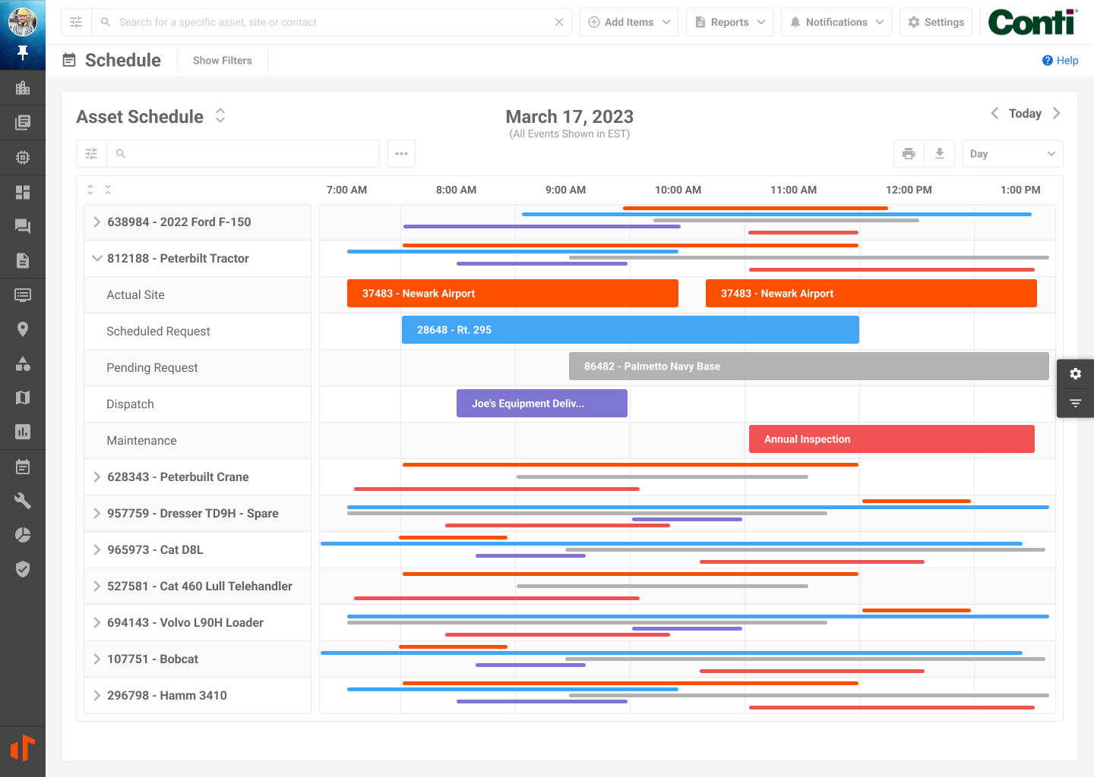
Schedule
Assets & Labor. Dispatch & Maintenance. All in One View.
At-a-glance calendar/Gantt chart of all current asset locations, pending requests, maintenance needs, and dispatch events.
Resolve conflicts, assign assets, manage work orders, and begin dispatch events from one easy-to-view tab.
Access a two-week look ahead, forecast for the quarter, analyze utilization, and accurately plan for upcoming jobs.

Slide 13
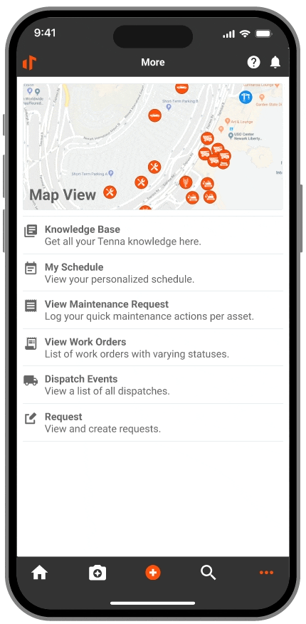
Schedule
  Personalized schedule in the palm of your hand.
  Click My Schedule from your dashboard to see tasks and requests specifically for you
  Day, week, and month views
  Keep projects on schedule with accurate task assignments
  Stay on top of pending requests

Slide 14
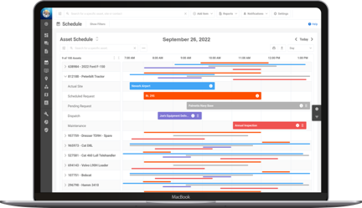
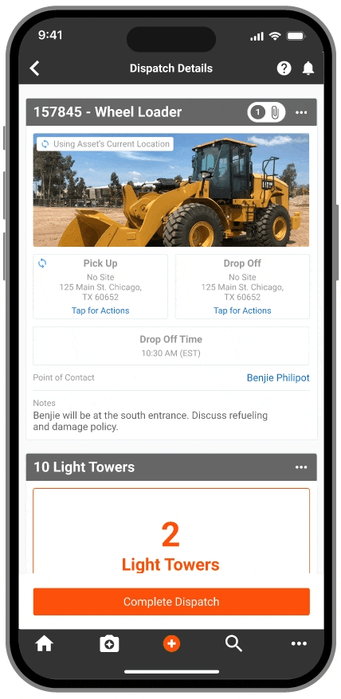
Why we’re different… and better​
In the field: Create a request for assets or labor resources easily without speaking to the dispatcher​
At the yard: See the schedule for an asset or labor resource​
In the office: Manage and dispatch assets and labor resources​
In the office: Review and make decisions on requests by leveraging insights from Tenna on utilization, upcoming maintenance, fault codes, scheduling conflicts, and more​
For the driver: See assigned pickups/deliveries or tasks for the day on mobile​
At a jobsite: ​Mark tasks and deliveries as completed​. Get signatures, photos, location confirmations, and notes for asset deliveries
Tenna features:
Live telematics dispatching​
Specifically designed for construction​
    Reminders on equipment attachments​
    Recommended assets for approval​
Automated notifications ​
Mobile dispatch tasks and load lists​
Permission-based request approval system

Slide 15

TennaSHOP
The TennaSHOP LinkedIn Group is a place for Tenna users to connect with one another to:
  Ask questions
  Talk about new and unique use cases
  Share best practices
  Share information about integrations
  Swap success stories
Keep in touch!
Come see us!
AEMP Connect
March 11-12
Las Vegas, NV
AGC Annual Convention
March 13-16
Las Vegas, NV
ConExpo
March 14-18
Las Vegas, NV

Slide 16
Geofences
February 24, 2023
1 p.m. EST
Custom Inspections/Safety & Compliance
March 24, 2023
1 p.m. EST
Next on
TennaU

Slide 17
Thank You

