Slide 1
Year in Review 2024
TennaU January 2025

Slide 2
Meet the Team
Jose Cueva
VP, Product
Sunil Puranik
Director, Product
Will Hipp
Product Analyst
Ross Porter
UI/UX Designer

Slide 3
Customer Support Team
888.836.6269
help@tenna.com
Meet our Support Team!
Available M-F 8am-8pm EST
Help Resources
Tyler
Katie
Ron
Jeremy
Don
Gabriel
Aehim
Scott

Slide 4
Introduction
New Products
New Integrations
Major Enhancements
Agenda

Slide 5
Poll
Who is joining us today?

Slide 6
New Products

Slide 7
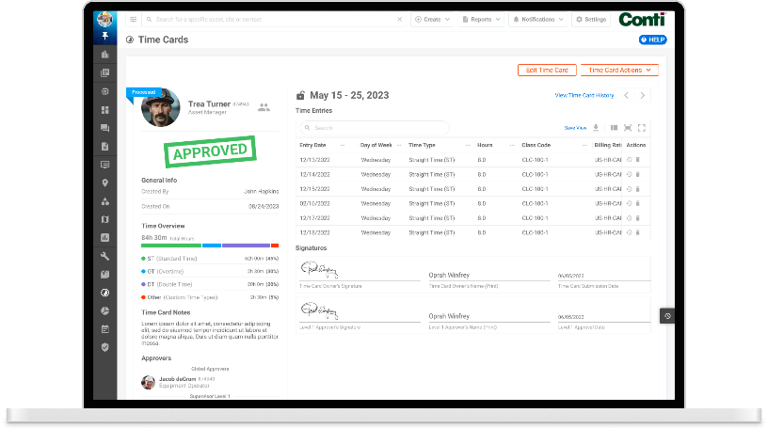
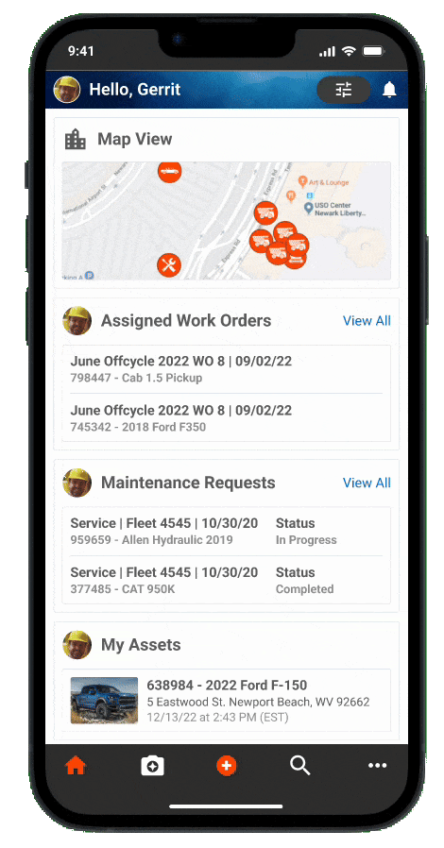
New! Mechanic Time Cards
Allow mechanics to easily capture their time against sites, assets, work orders, and maintenance requests.
Here are the key functionalities:
Time Capture and Entry for Supervisors and Mechanics
Time Card Approval Process
Data Synchronization & Exports
Notifications and Reminders
User permissions
Customization and Settings
Lifetime Labor Cost Tracking on Assets

Slide 8
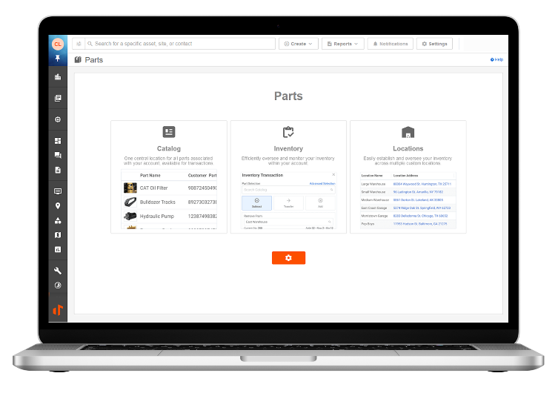
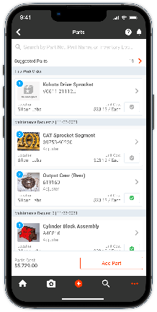
New! Parts
Take control of your parts inventory with a centralized, smart database.
Here are the key functionalities:
Parts Catalog & Pricing
Parts Inventory Management
Part Requests
Barcode Scanning
User permissions
Part Warranty
Notifications & Reminders
Lifetime Parts Cost Tracking on Assets
Notes:
Manage inventory on hand across locations
Get alerts on minimum/maximum quantities
Easily pull new parts from an industry-built database of parts
Keep track of costs, transactions, and moves across locations
Pull parts from inventory into a Work Order or Maintenance Request
Know the parts needed for each preventative maintenance
Maintain a record of the parts history of assets along with their usage (miles/hours/days) and the status of their warranties

Slide 9
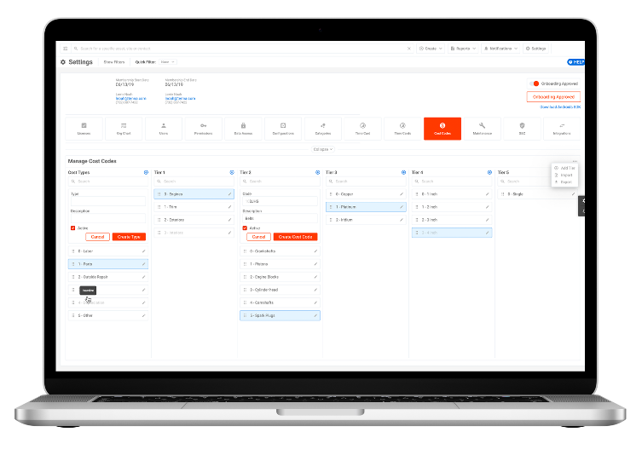
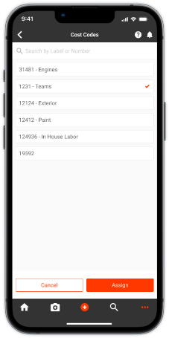
New! Cost Codes
Handle a crucial construction management function with Tenna Cost Codes.
Cost Codes facilitates informed decision-making and helps companies achieve increased profitability and efficiency.
Benefits
Improve cost tracking and transparency
Analyze costs across projects and sites
Map to existing ERP and accounting systems
Streamline resource allocation

Slide 10
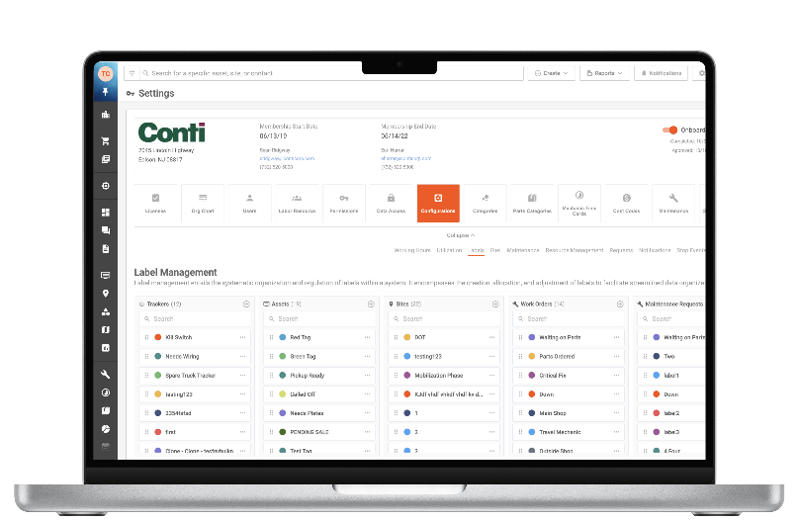
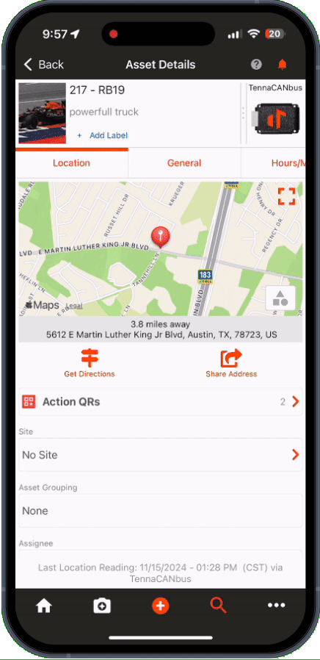
New! Custom Labels
Configure custom label sets for Assets, Trackers, Sites, Maintenance, Time Cards, Parts, Contacts, Laborers/Crews and Inspections
Assign unique names and colors to each label
Control label visibility by activating or deactivating
Determine the order in which labels appear in dropdown menus
View label creation and modification history
Report on label assignments
Notes:
Sunil New feature to define lables by specific entities Create as many as you would like, reorder, activate and deactivate
History to track changes on labels: Who, When, and What. Also How long, the label was applied. Big Value – Customers can tag, filter and report on anything based on their custom labels. This is going to help bridge the gap if customers have a unique use cases. Reporting Question: Labels in reporting will lag one release behind the feature being released. We aren’t snapshotting the other asset’s properties at that point in time a label was applied or removed. Labels: will live each product set

Slide 11
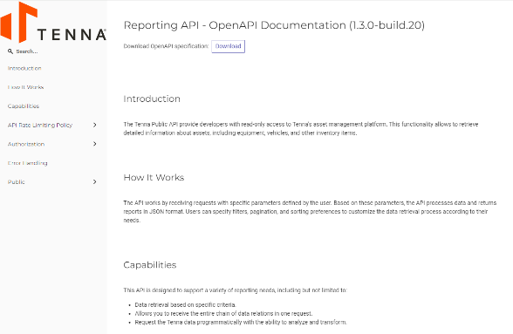
New! Open API
Share read-only Tenna data with your third-parties
Open API allows you to extract (not add or update) Tenna data for valuable use cases with other applications
Over 30 Endpoints Released
CORE and Premium Products Included
Benefits
Retrieve data from Tenna into your own database/cloud/data lake
Allow you to build your own dashboard in your own BI tool
https://help.tenna.com/article/645-open-api-overview

Slide 12
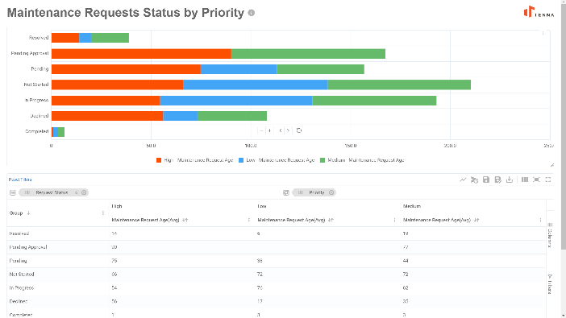
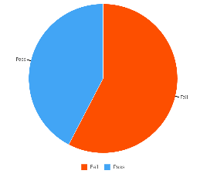
New! Reports
Over 60 New Detail and Analytical Reports!
Extremely Configurable:
Basic Report
Grouped Rows
Pivot Mode
Add Visualizations
Keep Private or Share with All Users
Areas covered:
Assets
Dispatch
Requests
Maintenance
Inspections
Location Reports
Time Cards

Slide 13
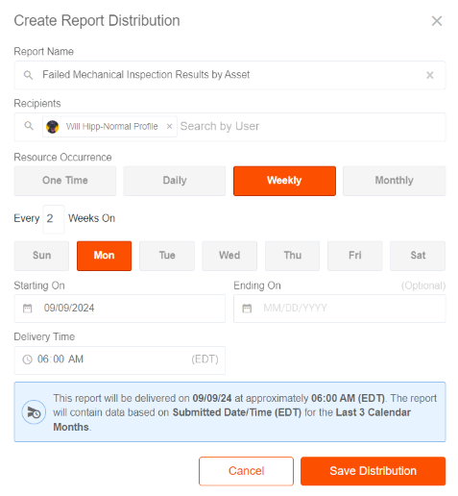
New! Reporting Engine
New! Schedule Distributions
Schedule Distributions for your team:
Easy Access to Relevant Reports
Great for Kicking Off Workflows
Assisting Low Tech Users

Slide 14
New! OEM Integrations
Tenna now supports the following OEMs telematics feeds to be integrated
Contact your Tenna Customer Account Manager for more information.
Notes:
Faults are supported by some OEM's

Slide 15
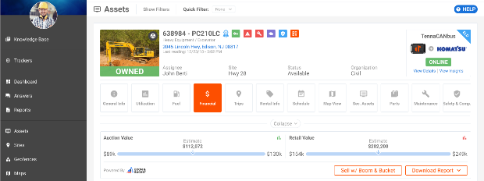
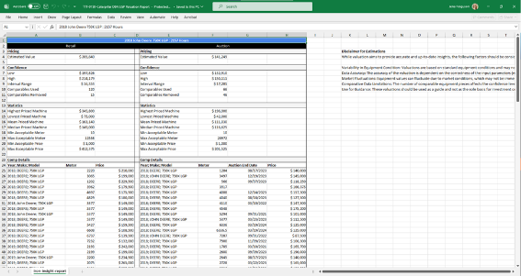
New! Boom & Bucket Integration
Boom & Bucket is a digital equipment dealer focused on heavy equipment and is changing the way that contractors buy and sell used heavy equipment.
Tenna is partnering with Boom & Bucket to enhance the Asset Details Financial Experience via API Integration.
Unlocks the user’s access to get real-time estimated residual market values of machines.
Allows a user to share the asset’s information on the Boom & Bucket website when they are ready to dispose of it.
Notes:
Will
Partnering with Boom & Bucket to provide key valuation data and ease of access to share equipment information when it is time to sell.
Great value at no cost to our customers:
Users will get this information for free.
This is permissioned, users will need to have access to asset financials to see this information.
First time posting with Boom & Bucket, a representative will reach out to help get you established.
Manually share inspections, maintenance records,

Slide 16
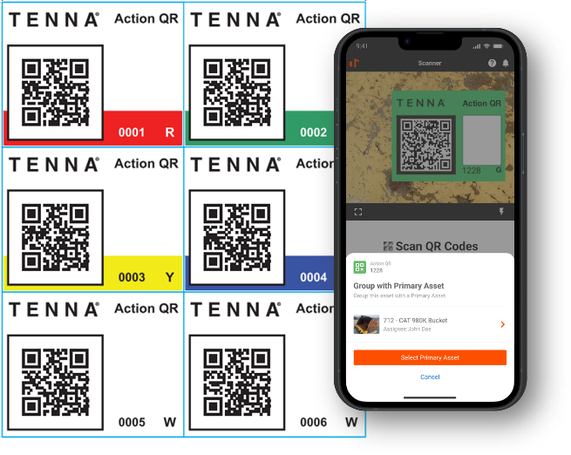
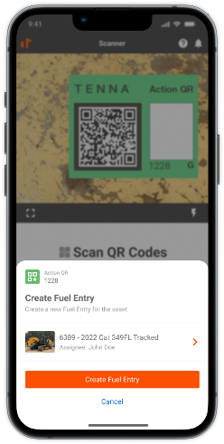
New! Action QR
Enable workflows in the field with Action QRs
Smart, durable QR labels can be scanned to complete many construction tasks. Actions include:
Asset
Assign to Me
Edit Asset Label
Create Fuel Entry
Create DVIR
Create Inspection
Create Maintenance Request
Create Work Order
And more!
Inventory Part
Inventory Transaction
Add to Work Order
https://help.tenna.com/article/643-action-qrs-overview

Slide 17
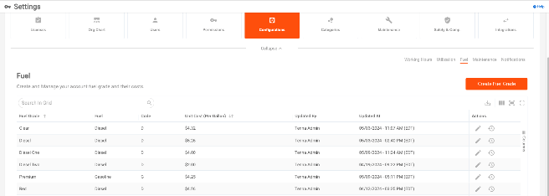
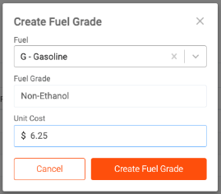
New! Vista Integration Fuel Cost and Entries
Seamlessly share fuel cost and entry data with your active Fuel Entry Integration with Viewpoint® Vista™
Tenna will send the following to Vista:
Fuel Type
Fuel Grade ID
Fuel Grade Name
Unit Cost
Extended Cost
Gallons
https://help.tenna.com/article/650-fuel-entry-integration-viewpoint-vista-overview

Slide 18
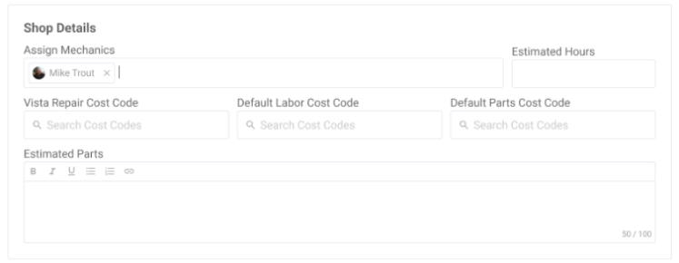
New! Vista Work Order Integration
Specify your Vista Cost Code as Repair Cost Code in Maintenance
Allow users to specify an existing cost code as a repair cost code at the PM Service and Maintenance Request

Slide 19
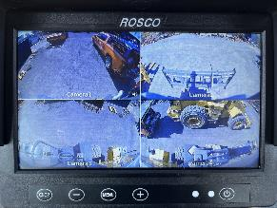
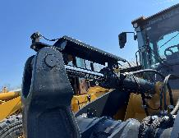
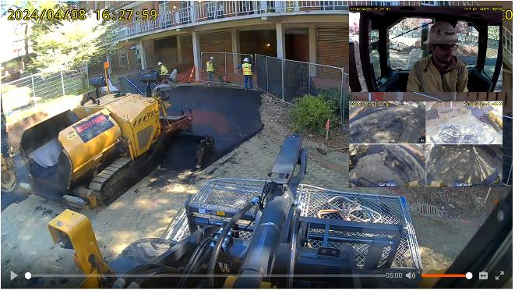
New! TennaCAM 2.0 Heavy Equipment
TennaCAM 2.0 + TennaCANbus offers 360° view for operators
Paired with a monitor and additional auxiliary cameras around the machine, this product provides footage and visibility around the operation and surrounding area of heavy equipment on active jobsites.
Increased jobsite safety
Improved visibility for operator
Video footage for liability purposes
Live stream into jobsites

Slide 20
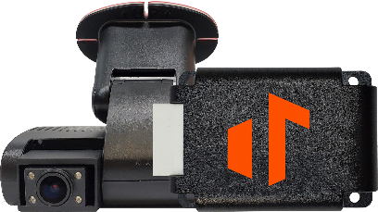
TennaCAM 2.0 Heavy Equipment
TennaCAM 2.0 Heavy Equipment Quick Specs
Camera is manufactured by Rosco— the Rosco DV6
Up to 360-degree visibility with use of auxiliary cameras and in-cabin monitor
Includes TennaCANbus
Optional recommended accessories
Auxiliary cameras for rear and side views
In-cabin monitor
Includes TennaCANbus
Best for Heavy Equipment with Enclosed Cabins
Excavators
Dozers
Loaders
Graders

Slide 21
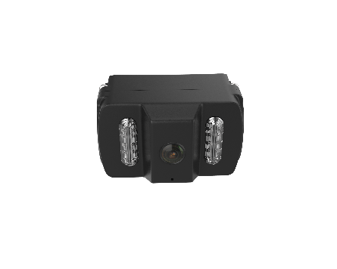
TennaCAM 2.0 Heavy Equipment: Accessories
Accessories Quick Specs
Auxiliary Camera
In-Cab Monitor
Live stream viewing, including in parking mode
Access video along with road-facing and in-cabin channels
Attention:
Does not provide backup guidance for reversing or parking assistance
Best for Heavy Equipment with Enclosed Cabins
Excavators
Dozers
Loaders
Graders

Slide 22
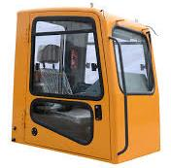
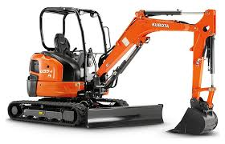
TennaCAM 2.0 Heavy Equipment is Best For…
YES
Closed Cab Equipment
NO
Open cab or NO cab
Can’t install on retractable windshields (or hinged windows – common on skid steers)
Can’t install on removable panels
On-road fleet vehicles (use TennaCAM 2.0 Fleet)
Watch Out For…
Swinging parts that could hit the camera (i.e., doors, panels)
Sunshields that could obstruct view

Slide 23
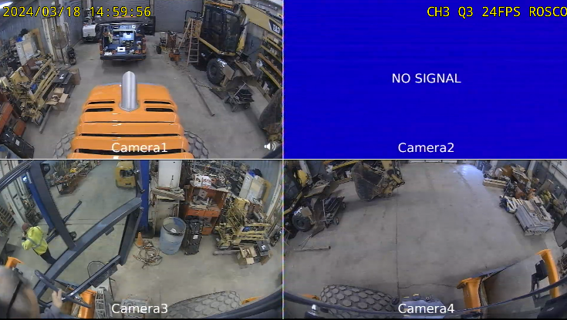
Hamm H12I Smooth Drum Roller Side Cameras Installation (Monitor View)
TennaCAM 2.0 Heavy Equipment Live Installation
Rear
Left Aux
Right Aux
20240322

Slide 24
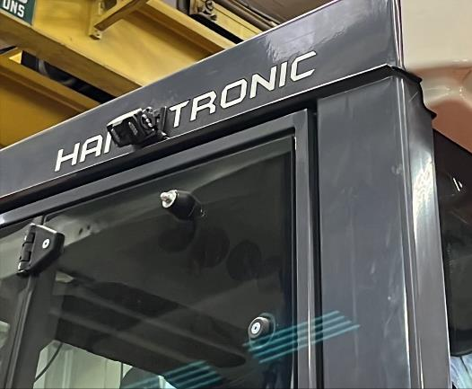
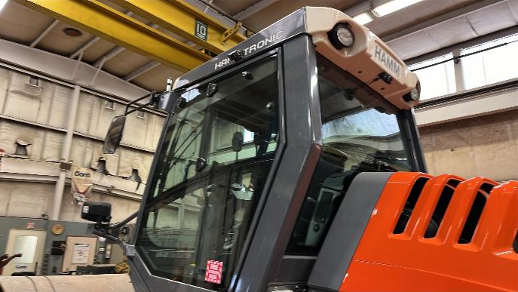
Hamm H12I Smooth Drum Roller Side Cameras Installation Location
TennaCAM 2.0 Heavy Equipment Live Installation

Slide 25
Hamm H12I Smooth Drum Roller Side Cameras Installation (Side Closeup View)
TennaCAM 2.0 Heavy Equipment Live Installation
Left Aux
Right Aux
20240322

Slide 26
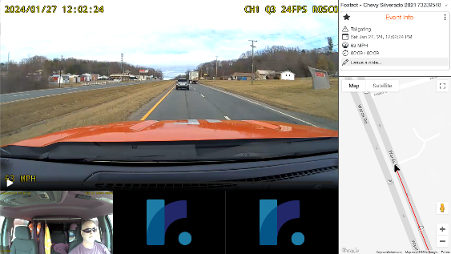
New! TennaCAM 2.0 Road-Facing AI
TennaCAM 2.0 now includes the option for Advanced Driver Assistance System (ADAS) in-cabin audio alerts.
The camera utilizes artificial intelligence to warn the driver of road-facing events. The following alerts are included in the TennaCAM 2.0 ADAS:
Forward Collision Warning: Alerts the driver of potential front-end collisions through calculations using speed of your vehicle and distance from a vehicle in front of you.
Headway Warning: Designed to assist drivers in maintaining a safe following distance.
Tailgating: Designed to alert drivers when they have maintained an unsafe following distance for an extended period of time.

Slide 27
Enhancements TennaCAM 2.0
Seatbelt and Smoking Monitoring
New Driver Management System (DMS) Events can be recorded for TennaCAM 2.0
Turn on or off
Choose alert and/or video
In-cabin driver coaching available
Note: Requires Custom Configuration and may require adjusting the viewing angle of the internal camera.
Notes:
Will
Seatbelt detection and Smoking
This feature won’t be enabled automatically, and the “Custom Configuration” License will be required to enable this feature.
Customers can enable or disable this feature.
Seatbelt monitoring works really well.
Camera viewing angle will need to be adjusted to capture more of the torso.
Only bring this up if we know the minimum speed:
The events and alerts require a minimum speed for this feature to register a violation.
Minimum speed is 5 miles per hour.

Slide 28
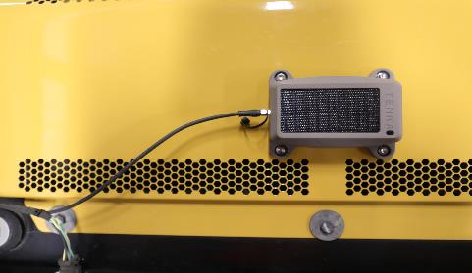
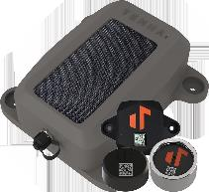
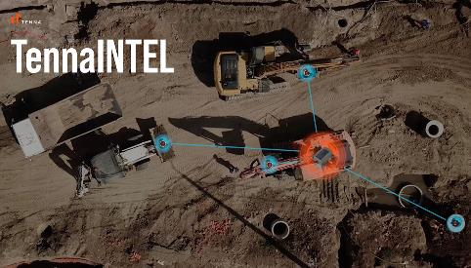
New! TennaINTEL P1/ TennaINTEL S1
TennaINTEL P1 is a plug-in tracker that can:
Calculate Utilization
Solar/Battery Recharge
Read TennaBLE trackers
TennaINTEL S1 is a solar tracker that can:
Ping on Motion
Solar Recharge
Read TennaBLE trackers
Notes:
The TennaINTEL P1 tracker is great for tracking heavy to mid-sized equipment 1 . It captures the location of the assets and reports it once every 23 hours 1 . Additionally, it can capture the location of surrounding TennaBLE beacons and alert contractors when an asset has left a geofenced location
Will
Evolution of TennaMini2.0.
Meant to be installed on Powered Assets
Same as out TennaMini2.0, but has the ability to read BLE beacons
No different than user phones picking up beacons.
How it works: the TennaINTELP1 communicates back to the Tenna Platform.
In that communication the TennaINTELP1 will communicate back all of the BLEs that it saw in a previous date range.
The assets associated with the BLEs, will receive timestamps and location updates from when the TennaINTELP1 last saw it.
Great use case for those who have smaller assets, tools and attachments that rely on BLE beacon.
If questions come up:
not meant to be a hub, it needs to be installed on a engine powered machine.
Reading range is limited by BLE and how it is installed, and same range that we know with Tenna App/Phones
Update rate:
If machine is running it will be every 2 minute
If the machine is off it will be every 23 hours
No geofence exit alert, it only knows if it was present, it doesn’t know when something leaves.

Slide 29
New! TennaBLE RT1
TennaBLE RT1 (Ruggedized Tag) tracker
Stay tuned for other new TennaBLE trackers for non-powered assets.
TennaBLE RT1 Installation Instructions
Notes:
Will
Ruggedized tag
Tested at IP68 rating which means that it keeps out dust and water really well
There is a loop at the top which accommodates a lanyard, and adhesive pad to affix to tools

Slide 30
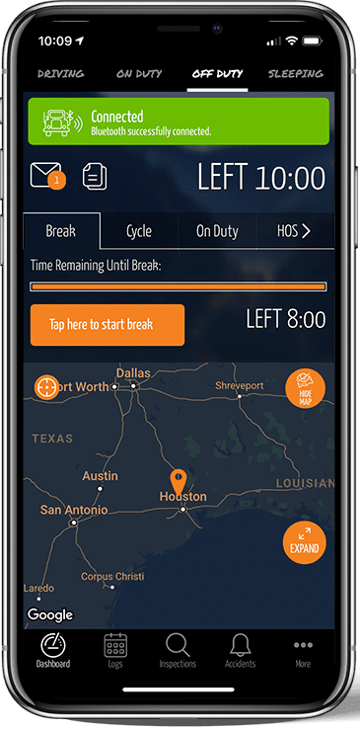
New! TennaCANbus + ELD
Tenna’s ELD powered by Gorilla Safety enables contractors to maintain the regulatory compliance they need for on road travel as an extension of their equipment management processes performed in Tenna.
Now extended to TennaCANbus trackers! Enable your heavy on road vehicles or equipment for HOS and ELD.
Notes:
Jose
We can enable a canbus + ELD tracker,
Usecase: Crane trucks, heavy trucks that need PTO tracking where the OBDII device isn’t a great fit.
It works the same way that a fleet tracker would, assuming it's on an on road vehicle.

Slide 31
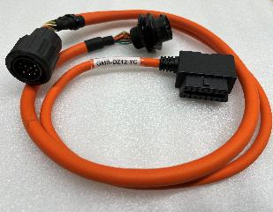
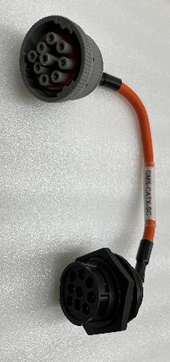
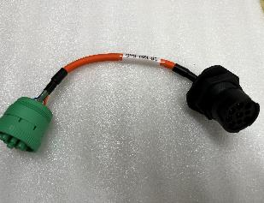
New! TennaCANbus Adapters
Newly added TennaCANbus Adapters:
Deutz 12 pin
Compatible with Deutz powered assets, Bomag, Hamm, Genie, JLG Lifts, Doosan Air Compressor (Deutz powered), Wirtgen, Gehl, Kawasaki Construction Equipment
CAT 9 pin Straight Cable
Compatible with newer CAT Skidsteers, CAT Telehandlers, and newer CAT Mini Excavators
John Deere 9 pin Straight Cable
Compatible with newer John Deere Backhoes

Slide 32
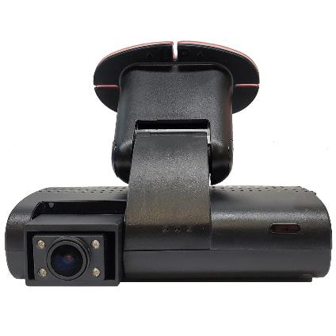
New! TennaCAM 2.0 Larger SD Cards
Larger SD Cards now available to expand storage capabilities for your TennaCAM 2.0
4x the storage capacity of a standard SD card
Easy to install/replace
Ideal for trucks that are heavily used

Slide 33
CORE Enhancements

Slide 34
Enhancements Assets
New Asset Fields
Users may now capture and report on the following information for their assets:
Warranties
By Hours
By Miles
By Date
Registrations
Dimensions & Engine Specs
Notes:
Multiple Warranties, Track status for each simaltaneously, schedule reports
Multiple Registrations, past registrations, status for each registration, schedule reports
Dispatching and Route Planning
Make sure the data is up to date to help in day to day operations and avoid delays

Slide 35
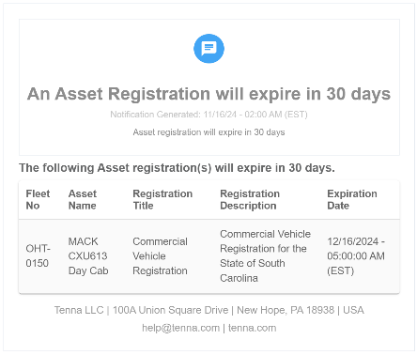
Enhancements Assets
Expiring Registration Notification
Get notified of upcoming registration expiration.
Notes:
Set up in advance and notify the right people in the distribution list
Helps to maintain Compliance across your fleet

Slide 36
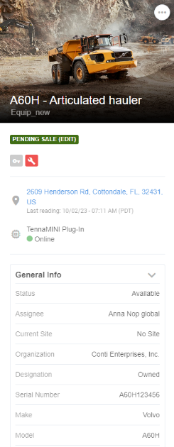
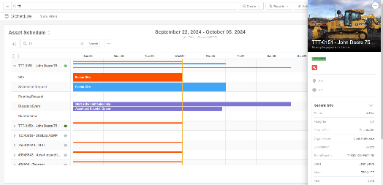
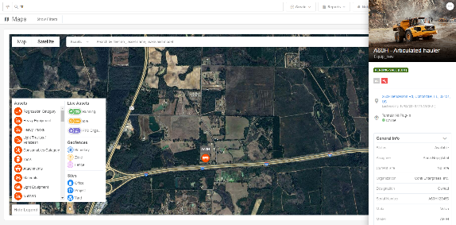
Enhancements Assets
New! Asset Details Side Panel
View Critical Information from any page!
Schedule
Resource Management
Maintenance
Sites > Assets
Maps
Notes:
General information
Dimensions
Engine Spec
Fuel Info
Uitlization

Slide 37
Enhancements Assets
Manually transfer an Asset without a tracker to a Site
Helpful for short-term rental assets that may not require a tracker
Allows users to keep track of which site a short-term rental or non-tracked asset belongs
New! Transfer Notes field
New! Site Transfer History log
DOES:
Produce Site Change notification (if configured)
Add asset to Site on Dispatch Board and allow for Scheduling
Transfer Location for Vista integration
DOES NOT:
Necessarily reflect latest location of the asset
Populate a physical location (lat/long) on asset details or map (asset location will still be N/A)
Populate in Geofence Enter/Exit Report
Notes:
Jose
Manual Asset Assignment to Site Without Tracker:
New capability allows manual transfer of an asset without a tracker to a site.
Particularly useful for short-term rentals where attaching a QR code or tracker isn't feasible.
Use Case and Benefits:
Enables linking assets to a site for reporting and visibility purposes.
Adds a new field to capture notes during the manual transfer process.
Site History and Notifications:
A log of all manual site history changes is available.
Generates site change notifications, which will appear on the dispatch board and update location changes in Vista.
Limitations:
The physical location of the asset will not be updated or shown on a map if the asset lacks a tracker.
Assets without trackers will appear on the site list but not on the map due to the absence of physical location data.

Slide 38
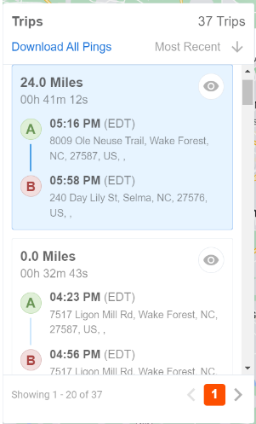
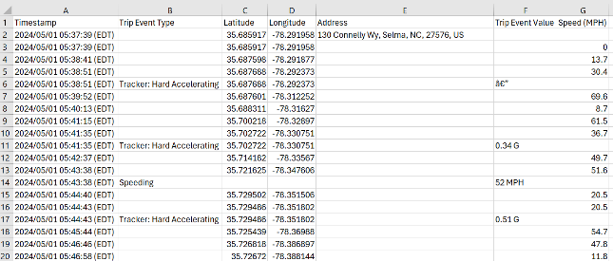
Enhancements Trips
Download All Pings for a custom date range
Keep your own records of asset movement and location updates
Get all the locations (pings) reported by assets for a date range.
Easily download into a csv or excel file for your records
Notes:
Supplemental data for IFTA and for other record keeping.

Slide 39
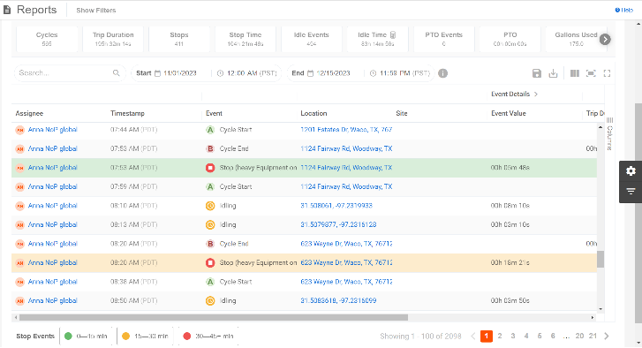
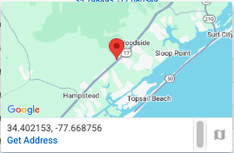
Enhancement Reports
Starts and Stops Report
Trip events will now include Lat, Long coordinates in Location column
For events that do not have an address
Hover over to view map
Notes:
Premium report
Now displays the coordinates if we cannot resolve an address for remote locations.

Slide 40
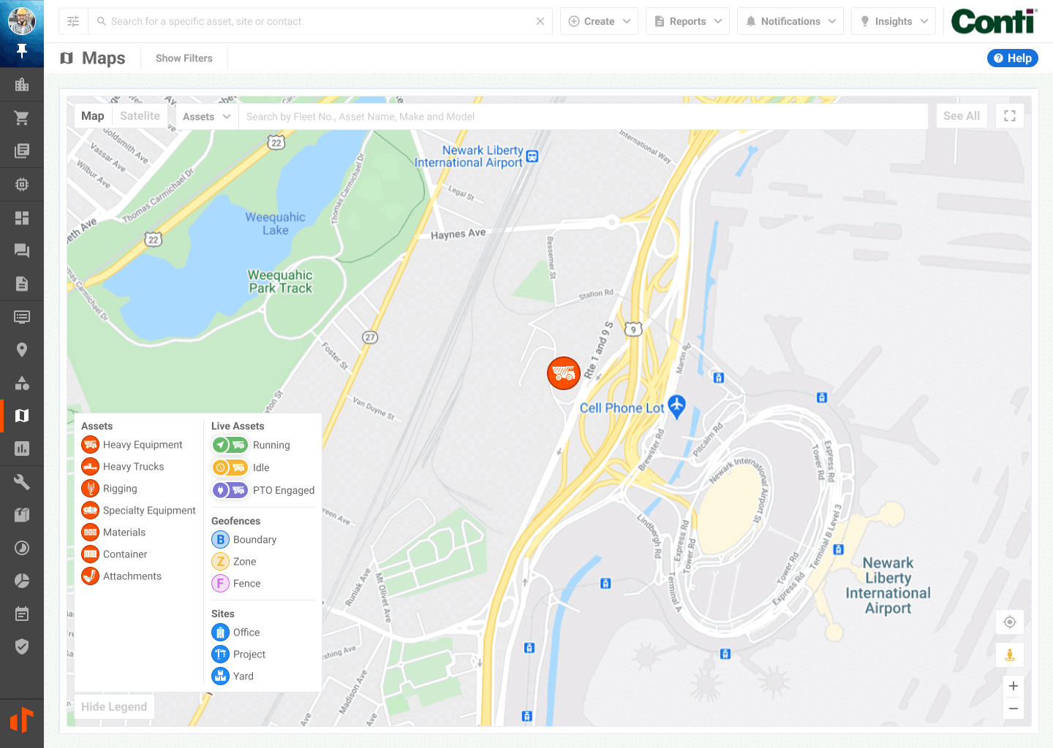
Enhancements Master Map
Find Nearest and Share Address
Quickly find and share the nearest asset or Driver/Operator (via the asset assignee) directly from the map
Easily share relevant addresses with other users
Add custom notes to the notification for greater clarity
Quickly share site address or job coordinates from the map
Notes:
Quick Response for emergencies, machine that is broken down, site accidents. Easily find the closest resources.
In addition to our resource management feature.
Pro tip, asign labels directly from the popover.

Slide 41
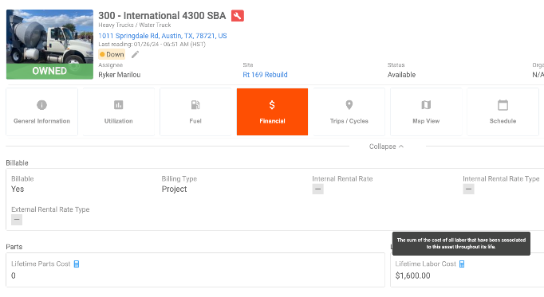
Enhancements Mechanic Time Cards
Lifetime Labor Cost in Asset Details
The Asset Details Financial tab will now show the Lifetime Labor Cost for that asset
Sum of the cost of all labor time entries that have been associated to the asset throughout its life

Slide 42
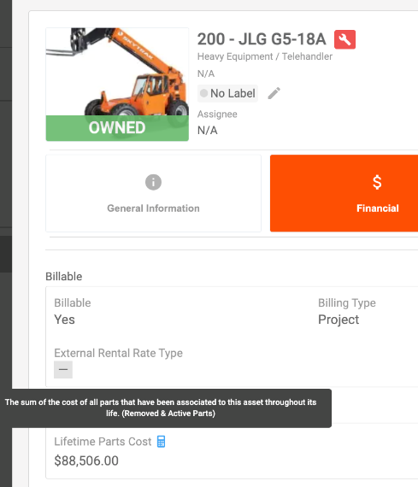
Enhancements Parts
Lifetime Parts Cost in Asset Details
The Asset Details Financial tab will now show the Lifetime Parts Cost for that asset
Sum of the cost of all parts that have been associated to the asset throughout its life
Includes removed and active parts

Slide 43
Resource Management Enhancements

Slide 44
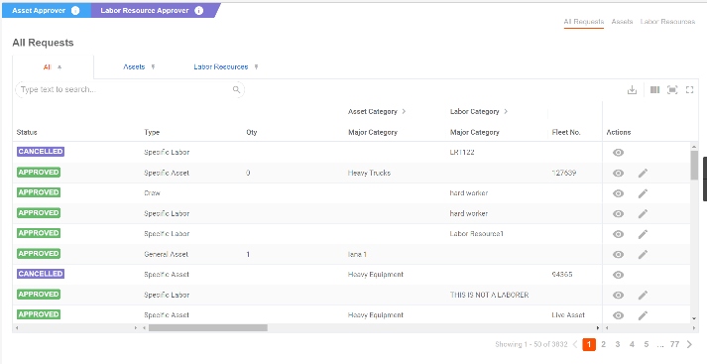
Enhancements Resource Management
All Requests Page
Approvers can now view all Requests in one convenient view
Includes assets and labor resources across the entire account
Must have "Approver" permissions to view these tabs
New filters for Requests and Dispatch Queue
Great for Decentralized Organizations
Requested By
Requestor Organization
And Many Others
Notes:
A lot of the enhancements to be covered in this section came directly from our users.
Here is a primary example. We heard from our customers that they need to see all requests for all sites, assets, laborers, crews regardless of who the requestor is.
Permissioned users can access all requests for Labor Resources and Assets. There are several beneficial filters that we have added to the
Permissioned users can cancel requests on behalf of others.

Slide 45
Enhancements Resource Management
Prioritize Requests
Communicate the importance of a Resource Request.
Requestor can Define Priority
Approver can Modify Priority
Request Priority flows to the Dispatch Queue, seamlessly informing the dispatcher.
Notes:
Will
Default Priority Setting:
Added request priority, to the requests form.
This default will not be changed by the system, but customers can choose a different priority if they wish.
Backfilling Existing Requests:
All existing requests that currently lack a priority will be backfilled with a "medium" priority.
This backfill applies retroactively, ensuring all past requests have a priority assigned.
Customer Flexibility:
Customers are free to edit the priority of any request, but "medium" will serve as the baseline default.

Slide 46
Enhancements Resource Management
Requests Notifications
Request Starting Soon
Get a heads up for asset and personnel moves with “Request Starting Soon” Notification
Request Ending Soon
Warn users that approved request is coming to an end tomorrow.
Options to Edit Request or Request Again
**The request must be greater than 48 hours to trigger a notification

Slide 47
Enhancements Resource Management
Dispatch Events
We've updated a few things on our Dispatch Events
The events are now tabulated based on status for an easier look
When selecting a site, the location will prepopulate
Delivery time is now an optional field
Delivery titles do not need to be unique
You can now clone dispatch events

Slide 48
Enhancements Resource Management
Dispatch Events
Include Crew/Laborer in Asset Tasks​
Include Asset/Reservation in Labor and Crew Tasks ​
Notes:
We understand that construction is very dynamic. The work that your business executes on often involves both assets and labor. In some cases like utility or industrial work, the labor resources perform the work with the support of assets
Other cases like paving or heavy civil work, the assets perform the work wit the support of laborers or crews.
We have taken that feedback and enhanced the Asset Task and Labor Task reports to meet the needs of your organization.

Slide 49
Enhancements Resource Management
Request Panel & Dispatch Forms
Send Resource Back to the Queue if your plans for dispatch change
Action from Panel
Schedule Pages
Request List
Action from Dispatch Event Form
Click “X” to Remove
Notes:
Continuing on the note of a dynamic nature of construction. Send Resource Back to the Queue if your plans for dispatch change
Requests and Dispatches are constantly changing. We want your dispatchers and logistics coordinators to successfully leverage our tools to meet that dynamic nature. Within the Panel, you can quickly check a request status via the side panel (in the schedule view, request list, dispatch board, dispatch queue).

Slide 50
Enhancements Resource Management
New Dispatch Event Notification
Detailed Notification that shares information about the dispatch
Header Information
Detailed Itinerary
Rich Text Notes
Notes:
New Dispatch Notification Leverages the recipient to notify field to share a dispatch’s details and itinerary for: Asset Deliveries, Asset Tasks, and Labor Tasks. every time the dispatch event is sent, this notification is triggered via Email and platform notifications.
Great use case for sharing dispatch event needs with internal and external parties. If an external contact is added as a recipient to notify, they will receive automated email notifications everytime the dispatch event is sent via the actions available in the Dispatch Event Grid or Dispatch From .

Slide 51
Dispatch SMS
Communicate Dispatch Events with partners, subcontractors, and outside service providers easily via text message.
Optional add-on to Resource Management
Typically for non-Tenna users that don’t have access to the mobile app or a smart phone
Message are sent to selected users from a third-party messaging service
Note: SMS Dispatch is part of a premium product, Resource Management, and requires a separate license.
Notes:
If your contacts do not have email set up or simply do not prefer email, we have introduced the Dispatch SMS notification. Great for ensuring your crew members and laborers are kept up to date with the dynamic construction schedule.
This feature is a premium product

Slide 52
Enhancements Resource Management
New Drag & Drop or Drag & Extend Actions in Schedule
Drag & Drop an event to a different date
Drag & Extend to change an event’s start/end dates and times
Notes:
We have enhanced the schedule view, which now supports drag and drop. This allows users to quickly edit the schedules associated with Assets or Labor Resources. Great for users that are busy, and have the need to quickly update the start and end times associated with events populating an assets or laborer’s schedule.

Slide 53
Enhancements Resource Management
Create Custom Schedule
Allows users to create the own custom schedule
Select relevant assets, laborers and crews to create a custom, user-specific schedule view
Pin your custom schedule for easy access
Notes:
Creating a custom schedule.

Slide 54
Maintenance Enhancements

Slide 55
Enhancements Maintenance
Enhanced Maintenance Flows
Capture Hours & Miles
Both maintenance requests and work orders now automatically record the asset's hours/miles at the start and the completion of the maintenance requests and work orders.
Enhanced Maintenance Financials
Capture your legacy maintenance costs as a baseline, start tracking parts, labor, and total R&M on all your assets.
Notes:
Auto captured – Can override in case of discrepancies – Flexibility
Enables trend reporting to identify failures and bottlenecks to assist with sell / rent decisions.
Capture a baseline r&m value directly from another system.
The total cost of all your completed work orders or maintenance request costs is automatically rolled up to the asset lifetime R&M cost

Slide 56
Enhancements Maintenance
Enhanced Work Order Details
Take Control of Your Work Orders: Track, Label, and Optimize.
Ability to add Parts & Labor *
Ability to Assign and Report on Cost Codes
Track Equipment, Service Vendor and Misc. Costs
Assign Labels to a work order
Enhanced Cost and Billing Summary
Customer Copy Print View for Work Orders Billed to a 3rd Party
*Requires Additional License​

Slide 57
Enhancements Maintenance
Enhanced Work Order and Maintenance Request Grids
Streamlined Work Order Management: Perform bulk actions (print, print client copy, approve, submit for approval) from the work order list
Streamlined Maintenance Request Management: Perform bulk actions (Add to existing work order, Create new work order, Acknowledge, Resolve, Decline, Delete, Add Labels) from the maintenance request grid
New Filters: Filter work orders by asset org and category
Notes:
Sunil
Enhanced Bulk Actions and Filters:
Introduction of additional bulk actions and new filters, improving efficiency.
Maintenance requests now have similar bulk actions with a refreshed look.
Bulk print to get maintenance history on an asset.

Slide 58
Enhancements Maintenance
Specify Maintenance Request Defaults in Preventative Maintenance
When Tenna generates a maintenance request from a Preventative Maintenance Service, the service's specified "Defaults" are applied to the Maintenance Request.
The defaults include
Priority
Request Type
Default Labor Cost Code
Default Parts Cost Code
Labels

Slide 59
Enhancements Maintenance + Sites
Enhanced Site Maintenance Views
Site details now display maintenance items for all operating assets. The following grids are now available
Preventative Maintenance
Upcoming
Open
Completed
Work Order Tabs

Slide 60
Enhancements Maintenance + S&C
Enhanced Failed Inspection Trigger
Prioritize and Categorize in Advance
Inspection Check Items now allow users to define default maintenance request types and priorities for failed inspection items, improving your maintenance request workflow.
Notes:
Sunil
Example: hydraulic leaks, fluid levels etc..
Smarter Compliance and Inspection Forms:
Inspection forms can now select a default maintenance request type and priority if an item fails during inspection.
This allows for pre-coded and pre-prioritized maintenance requests based on inspection results.
Streamlined Workflow and Cost Code Integration:
The system is designed to standardize processes upfront, reducing errors and making it easier for field workers.
Cost codes now flow seamlessly from inspection forms to reporting, eliminating the need for manual selections.
Future Enhancements:
Additional improvements are planned to make the system even smarter, focusing on standardization and efficiency.

Slide 61
Enhancements Maintenance + S&C
Work Orders and Maintenance Requests Fix Failed Check Items on Completion
Quickly mark items as “fixed” from a failed inspection once the related Maintenance Request or Work Order is resolved.
Streamline your maintenance workflow when it includes items added from a failed inspection.
Added flexibility to mark items as fixed once Work Order is completed.
Notes:
Eliminates need for manual updates and ensure the loop is closed with the safety / inspection team.

Slide 62
Enhancements Maintenance
Work Order Smart Cost Fields
Automatically calculate total costs of Parts, Labor, Service Vendors, Equipment, and more
Add individual line items such as parts or vendor costs with the appropriate cost code and financial information
Totals will be calculated for each section and for the Work Order in general
Selecting the totals will open a breakdown with more specifics

Slide 63
Maintenance Enhancements
Work Orders
Enhanced Work Orders Cost & Billing
Improved Cost & Billing: Separate work order billing and cost summaries for better record-keeping
Flexible Billing Options: Mark work orders as billable and generate detailed billing summaries for third-party clients
Improved Client Communication: Generate a printable client copy of the work order
Granular G&A, Markup and Tax: Implement granular control over G&A, markup, and tax by specifying defaults, applying G&A exclusively to cost items, and calculating markup and tax on specific billed item categories for accurate cost distribution and improved financial tracking.
Notes:
Enhancements to Work Orders:
Significant improvements have been made to costing and billing within work orders.
Work orders can now be more clearly flagged as billable or non-billable, with additional options for billable work orders.
New Billing Features:
A new billing summary provides more detailed billing information.
A print view has been introduced, designed for external parties, especially useful when billing them.
Costs and billing are now separated into distinct categories:
G&A (General and Administrative costs) are categorized on the cost side.
Markup and Tax are now on the billable side.
Customization and Flexibility:
Users can now apply different markup rates for billable items, such as mechanic time or parts, compared to costs.
Clarification and Data Separation:
Previously, there was confusion between costs and billable items within work orders.
Now, these items are clearly separated, with two different records and data sets in the database.
Improved Reporting:
Users will eventually be able to run reports comparing billing amounts to actual costs for specific cost codes and maintenance activities.

Slide 64
Safety & Compliance Enhancements

Slide 65
Enhancements Driver Scorecard
Customer-defined speed violation overrides
Create custom speed overrides for specific road segments to improve the accuracy of your speeding violations
Disable speeding violations entirely or
Set a custom speed limit
Important! Applies only to subsequent speed violations and is not retroactive.
Notes:
Will
Customers can choose to set their own speed limit for certain road segments that they disagree with.
There has to have been a violation in order to void a road segment.
New roads that aren’t done being built or are under construction.
Instances were industry service providers may have an incorrect limit. I-95 minimum speed allowed got captured as posted speed of 40MPH. I as a user could go in and override that segment to be 80 MPH. No more violoations going forward. Going from Hardeevill, SC to Savannah, GA on I-95, there is a ½ mile section that external services have marked as a 40 MPH limit. The actual speed is 80 MPH, but there is a minimum speed sign that accidentally got

Slide 66
Enhancements Driver Scorecard
View and Edit Speed Rules for Driver Scorecard
Easily view and manage all your speeding violation rules via Settings > Safety & Compliance > Violation Rules
See previously set speed overrides
Edit the speed or rule
Note: changes applies to future violations and does not affect existing scorecards.
Notes:
Jose
Override Speed Limit Violations:
Introduced the ability to override specific road segments with custom speed limits or to disable speed limit alerts for those segments.
Rule Management:
New feature allows users to manage all override rules in settings and configurations.
Users can view and edit existing rules as needed.
Enhancement to Previous Release:
This update complements the feature introduced in the last release (04), expanding its functionality.

Slide 67
Mobile Enhancements

Slide 68
Enhancements Tablet Support
Optimized the Tenna App for tablets
Use in landscape or portrait mode

Slide 69
Enhancements More Page
New and improved! More Page
A header for You and your features
Quickly access your profile and Schedule
New Pinned Section allows easy access to your favorite workflows
Swipe left on features in the more menu to pin them
To un-pin, swipe left again on the feature
Features are now grouped by their license

Slide 70
Enhancements
Share Directions to a Live Asset
Easily share directions to the latest location of an asset that is running/live.
Tap on the Address to copy or open in Google Maps
Tap on the Share Icon to share to in a text, email, etc.

Slide 71
Enhancements Asset Details
New Parts Tab in Asset Details
View the parts that have been used by an Asset across its life in the new Parts tab within Asset Details
View, Search and Filter all the Active and Removed parts associated to the Asset
Tap on a Part to View the asset part record:
Association Date
Association Miles / Hours
Part Life
Transaction details
Warranty Info
And More!
Notes:
Ross

Slide 72
Enhancements Parts
Add Parts to a Maintenance Request in Tenna App
View, Manage, and Add Parts to Maintenance Requests

Slide 73
Enhancements Parts
Add and Remove Parts directly to the Asset
Add Part
Within Asset Details / Parts, select "Add Part" to directly add a part to the asset
Remove Part
Within Asset Part Record, select Remove Part to remove it from the asset
You can add / edit the following during removal
Removal Date
Hours / Miles at Removal
Removal Notes

Slide 74
Enhancements Parts
View and Create requests for parts in maintenance
Parts can now be requested within Work Orders and Maintenance Requests
Tap new "Requested Parts" button to view the requested parts for the MR or WO
Requests a part while adding it to the Work Order OR tap on the new part action menu to request
Tap on a requested part to get details on the request, edit, fulfill, or cancel the request.
Notes:
Ross

Slide 75
Parts Barcode Scanner
Assign and Search Catalog Parts by Barcode.
Barcodes on parts can now be scanned and assigned to Catalog Parts for streamlined access.
Tap on the barcode icon within the Parts Catalog search bar to access the Barcode Scanner
Scan the Part
New barcodes can be directly assigned to a catalog part
Once assigned, scanning the barcode will provide immediate access to its catalog details
Scanning a New Barcode
Scanning an assigned Barcode
Barcodes can be also Assigned & Unassigned from the Catalog Part Detail Page
Tap on the quantity of Barcodes or on "Part Actions"
Scan the barcode you intend to assign or unassign
Notes:
Ross

Slide 76
Part Requests
Part Requests Enhancements
Part Requests can now be created, viewed, and managed on the Tenna Mobile App.
Create a Part Request from scratch via the Create button or the list page
View all and itemized Part Requests from the more page
Tap on a Part Request to manage the request via the details page
Tap on Request Actions to:
Edit request details
Request additional parts
Update inventory upon fulfillment of Part Requests
Notes:
Ross

Slide 77
Enhancements Work Orders
"Add" Work Order items from one place
Users can now add Parts, Time Entries, Costs, and attachments from Work Order Details
Easily add items by tapping on the "Add" action and select an item
Note: Individual actions are permission controlled
Note: This replaced the “Make Updates” state and action.

Slide 78
Enhancements Work Orders
New Cost Summary
Users can now view and add line items for Equipment, Service Vendor, & Misc. Costs from the Cost Summary
Tap on the Cost Summary component in Work Order details
Tap on the cost to view a list of each
Totals will be calculated for each section and for the Work Order in general
Note: The Cost Summary is no longer a part of the Create Work Order form; costs added after creation in Work Order details

Slide 79
Create Work Order Optimization
Select Asset
Work Order Details
Schedule & Assignments
Scheduled Start & End will Defaults to current date
Add or Create Maintenance Requests
Notes:
Smarter Create Work Order form Updated Create Work Order form is shorter and smarter, requiring less clicks and time for users in the field.

Slide 80
TennaCAM 2.0 Realign Tracker Details
Easily check and adjust camera alignment for TennaCAM 2.0 Fleet cameras already installed
Review ideal camera alignment from Tracker Details
Select the "Realign Camera" action from the header or the installation info tab to quickly check camera alignment for all sources
Notes:
Ross
Realign Tracker Feature:
New feature allows customers to realign the camera on demand through a button called "Realign tracker" on the mobile app.
Useful for ensuring proper alignment post-installation.

Slide 81
Mobile Part Requests
Adjust Part Inventory upon Fulfillment of a Request
Upon fulfilling a part request (itemized), you can directly add the parts to your inventory. Close the loop with your Parts Department or Shop Manager by updating inventory for the parts being received.
When an itemized request is "Fulfilled", a modal will provide the option to adjust part inventory.
Directly add inventory to the part, the location and quantity requested will be automatically populated.
Notes:
Ross

Slide 82
Enhancements Maintenance
Access Preventative Maintenance from Tenna App
Enjoy a new Preventative Maintenance tab, accessible from the More Menu and Asset Details Page in the Tenna App
Access Upcoming, Open, and Completed Preventative Maintenance
View Preventative Maintenance for all assets via the more menu
View Preventative Maintenance for a specific asset via Asset Details
Tap on an Upcoming Service to Trigger, Reschedule or Cancel the service
Sort by days/hours/miles remaining (Upcoming) and overdue (Open)

Slide 83
DTC and Fault Codes Feature
Access DTC and Fault Code Lists for all Assets
View, Sort, Filter and Bulk Edit the Lists
From the More Menu, tap on DTC or Fault Codes to get a full list of received codes
Filter by asset, acknowledgement, date received, and more!
Select bulk edit to quickly acknowledge codes in bulk!

Slide 84
Enhancements Inspections
Save In-Progress Inspections or DVIRs
If a session is ended mid-inspection, all progress, notes, and photos will be saved in the Tenna App for the user to resume later*
User will be prompted to resume previous inspection when they attempt to start new one
Users have the freedom to 'pause' their inspection, complete other tasks in the Tenna app, and then resume their inspection
Users are covered for unexpected app closure (manual error, device out of battery, etc.)
*Only one form will be saved per device

Slide 85
Enhancements Inspections
Apply Hours/Miles captured in DVIRs or Inspections to Assets
Users may now apply their entered Hours or Miles in inspections to the Asset’s current values by checking the “Apply to Asset” button.
Hours updates are accounted for Asset Utilization calculations
Users can also include a photo of the hour meter or odometer on the asset by tapping “Add Photo”
Note: Users cannot apply hours/miles to a value that is less than the current value on the asset or to an asset utilizing ECU value.
Note: These updates will show in the Manual Log of Updates on the Asset Details page

Slide 86
Released in 2024
20+ New Products
Software
Reporting Engine
Mechanic Time Cards
Cost Codes
Parts
SMS Dispatch
Custom Labels
Hardware
TennaCAM 2.0 Heavy Equipment Cam
TennaCAM 2.0 Road-Facing AI
TennaCAM 2.0 Larger SD Cards
TennaCANbus + ELD
TennaINTEL P1 and S1
TennaBLE RT1
ActionQR
Integrations
OEMs: Develon, JCB, Liebherr, Takeuchi,TESMEC, and Vermeer
OpenAPI
Boom & Bucket
70+ Key Enhancements
Software
Assets
Maintenance
Maps
Mechanic Time Cards
Parts
Reports
Resource Management
Safety & Compliance
Trips
Users
Hardware
Custom TennaCANbus adapters
TennaCAM 2.0 Seatbelt and Smoking Monitoring
Integrations
Vista Fuel Entry
Continuously adding Open API endpoints
Various Tenna App Enhancements!

Slide 87
Questions?

Slide 88
Tenna
Knowledge
Base
Resources on these topics (and more!) can be found in our help library

Slide 89
More Chances To Learn
Next product release coming soon!
Tenna Live Launch
February 13th at 1 PM EST
Check your inbox!
How’s your Tracker Health?
Don’t know, then contact us for Tracker Insights Training Session!

Slide 90
Poll
What topics are you interested in covering in future Tenna training sessions?

Slide 91
Stay Connected
TennaSHOP
LinkedIn Group for Tenna users to connect with one another to:
Ask questions
Talk about new and unique use cases
Share best practices
Share information about integrations
Swap success stories
https://www.linkedin.com/groups/9034188/
Come see us! We’ll be speaking or exhibiting at the following events:
World of Concrete
1/21-1/23
Las Vegas, NV
Tenna/Gearflow "Pre-Con"
3/04-3/05
Arlington, TX

Slide 92
Thank You

